Slide 1
all about ASpace
Implementing ArchivesSpace at the Bancroft Library
Kate Tasker
Digital Archivist
The Bancroft Library, UC Berkeley
ktasker@library.berkeley.edu
@kate_tasker
Notes:
[Slide 1]
Hello! I’m Kate Tasker, Digital Archivist at the Bancroft Library at the University of California, Berkeley and the point person for all things ArchivesSpace at the Bancroft. I want to thank SCA and the Gold Country Archivists for having us here today; my wonderful fellow presenters; and all of you for joining us at this session. I gave a shorter version of this presentation as a Lightning Talk at the Western Roundup in May, so some of this may be familiar to any of you who attended. Don’t worry though – I’ve added some new stuff!
To start us off: I have to confess that I’m really susceptible to ear-worms, probably like many of you: those songs that get stuck in your head and seem to play on endless repeat. Last year when I was starting to work on ArchivesSpace (or ASpace, as we quickly nicknamed it), Meghan Trainor’s song “All About That Bass” was everywhere. Around the same time a group of interns at NASA posted a video on YouTube with their parody lyrics to “All About That Space”, and I’m afraid I felt inspired to make my own version.
So (with advance apologies) I’d like to tell you how we’re All About ASpace at the Bancroft Library.

Slide 2
The Bancroft Library at UC Berkeley
1 of 20 campus libraries
One of largest special collections libraries in U.S.
60 mil. manuscript items (60,000 LF)
8.2 mil. photographs & pictorial materials
600,000+ volumes
86,000 microforms
25,000 maps
24.4 TB of digital collections
Notes:
[Slide 2]
As a quick intro, The Bancroft is one of 20 libraries on the campus of UC Berkeley. (Our next speaker Emily Vigor will talk about implementing ASpace at another Berkeley library, and I’m lucky to have other colleagues on campus for support as we all tackle similar issues.)
The Bancroft is one of the largest special collections libraries in the U.S., as you can see by this description of our holdings. Collection records have been kept electronically in a custom Access/MySQL database since 1997, but other administrative information has also been recorded in paper collection files and in individual unit databases. Due to the complex nature of collection management and staff needs, the Bancroft has never adopted Archon or Archivists’ Toolkit.

Slide 3
“…because you know we’re all about ASpace”
…all levels
Comprehensive collection management system
Accessions, Resources, Events, Digital Objects
archivesspace.org
Notes:
[Slide 3]
But we are now all about ASpace, ‘bout ASpace, all levels, as a way to manage our collection records in one comprehensive system. We are particularly making use of the Accession, Resource, Event, and soon the Digital Object modules, but have no plans yet to deploy the public interface (as we present our finding aids through the Online Archive of California and have our digital collections in Calisphere/DPLA). We are ASpace charter members at the “Very Large” level.
My unit, the Digital Collections Unit, administers our ArchivesSpace instance for users. All technical support and database management falls to our Library Systems Office IT staff. We set up an ArchivesSpace Task Force in June 2014, which meets approximately 1-2 times per month to set policy, write guidelines and procedures. We have 8 members representing Acquisitions, Manuscripts, Pictorial, Digital, and Cataloging needs. We also have a sub-group currently meeting to update our manual in light of new features and bug fixes in the latest version of ASpace. Bancroft staff received formal ArchivesSpace training from Brad Westbrook and Adrian Turner in May 2014; our production instance was launched in June, and we officially began entering new Accessions on July 1, 2014. Finding aid production, development of procedures, and migration of legacy data has been ongoing since then.
We wanted to begin using ASpace immediately, even though that meant checking and maintaining two separate collection management systems in the short-term. We learned how to best use the application simply by starting to work with it; we also began to collect feedback from users and evaluate our use and migration needs, and to write a user manual. Implementing the application also allowed us to participate in early discussions with the community and to make feature requests for later development. Creating new Accession records and Resource Records was relatively straightforward, but migrating our legacy data…that’s a different story.

Slide 4
“…yeah, it’s pretty clear, what we had to do”
migrate, migrate: a database or two
Legacy MySQL database (“ECMS”)
~14,800 collection records
XML finding aids: ~1286
Assorted legacy records
Notes:
[Slide 4]
So yeah it’s pretty clear, what we had to do: we had to migrate, migrate, a database or two. The majority of collection records were managed in a custom MySQL database with a Web interface called ECMS (for Electronic Collection Management System). It contained over 14,800 collection level records, with another 15,000 processing records for different formats. We also have nearly 1300 large EAD finding aids which we want to bring in as Resource Records, not to mention other records stored in pictorial and University Archives databases. Migrating all of this information as consistently as possible, according to the ArchivesSpace application parameters, is obviously important…

Slide 5
“…all the right fields in all the right places”
Mapping
ArchivesSpace technical documentation:
http://www.archivesspace.org/importexport
Select source data
Policy decisions on field definitions and use
Match ECMS data with ASpace fields
Define necessary transformations
Notes:
[Slide 5]
‘Cause we want that metadata, that all the staff chase: all the right fields in all the right places.
We started mapping fields in our ECMS collection records to ASpace, using the technical documentation and standard Accession CSV template on the archivesspace.org website. We had to decide which fields we were going to use and how we were going to use them- this was a lengthy process that necessitated reviewing and revising current descriptive practices and procedures. Then we had to get our legacy data into shape- transforming text strings into machine-readable values, combining separate fields into one, or parsing one field into many. We also had to go back in and add data that was missing for ASpace required fields (for example, Accession IDs, dates)

Slide 6
ECMS Collection Record
Notes:
[Slide 6]
ECMS Collection Record: here’s a screenshot of a typical collection-level record in ECMS, as viewed through the web interface

Slide 7
ArchivesSpace Accession Record
Notes:
[Slide 7]
ArchivesSpace Accession Record: and here’s a screenshot of a blank Accession Record in ASpace which we mapped to (using version 1.0.9)

Slide 8
Mapping Spreadsheet
Notes:
[Slide 8]
This is what a portion of our mapping spreadsheet looked like, with transformations highlighted in pink. Grey indicates ArchivesSpace fields which we couldn’t map to, using our data.
Examples:
In ECMS a field labeled “Donor Restrictions Apply” was filled in using a drop-down menu with choices “Yes” or “No.” We had to transform this to a Boolean value (a 1 for Yes, a 0 for No) for ArchivesSpace, which uses a checkbox to indicate Donor Restrictions. A 1 means the checkbox is checked, a 0 means it’s left unchecked.
ArchivesSpace has a field to record a collection processing plan; we had no such equivalent field in ECMS.

Slide 9
Test Migration Table
Notes:
[Slide 9]
And the end result, our test migration table. This was a long process that required the expertise of several staff to run queries and scripts in the MySQL database, export data to Excel, and format it in the correct order for the ArchivesSpace importer. We coordinated at some stages with our Library IT, but in the end performed the migration import ourselves.
After several iterations and trial-and-error in our development instance, we were able to upload 14,853 records in 15 upload batches to our main production instance (we possibly could have done this in fewer batches, but since an error in one record could make the whole batch fail, this made it easier to pinpoint problems). We successfully migrated all ECMS records on March 17, 2015, and have since retired the old ECMS as a read-only reference copy.
I hope that most of you aren’t looking at a large custom data migration like this one, but if you are: take heart. You can do it. I had very little knowledge of data migration or scripting when I started, but it became much clearer as I went along and experimented. Even if you don’t have any access to the backend database or tables (which we didn’t, and still don’t) you can do a huge amount through the user interface. Always always test in a dev or sandbox instance first, which you can wipe out if you have to. Take lots of notes so you can see what you tried and what worked (or didn’t work). Ask other ASpace users for help (you don’t have to be a member to be part of the community, and even if you’re not a member you can still see the listserv archives where a lot of great questions have been asked and answered).

Slide 10
“every inch of it is perfect from the bottom to the top” (…almost)
Notes:
[Slide 10]
Our mapping worked mostly as planned, but we did get some unexpected results from a combination of our data and ASpace behavior. For example, we mapped to the Processing Priority field in the Collection Management module, but records which had no data caused the field display to go a little haywire, like this [example on next slide]

Slide 11
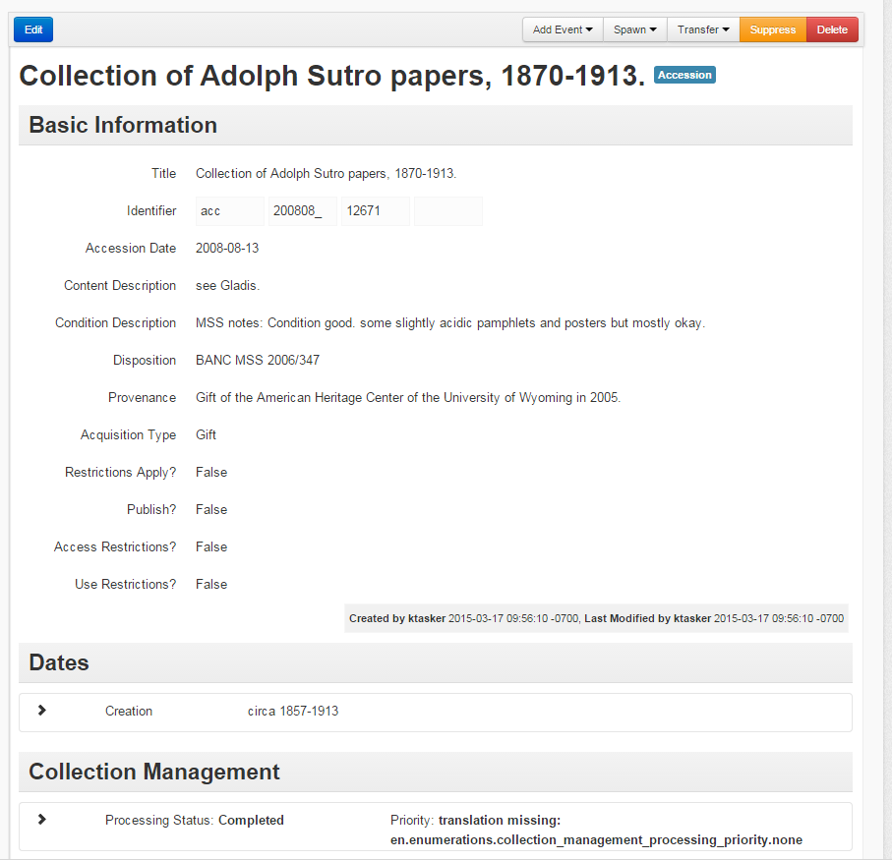
Notes:
[Slide 11]
This is something we’ll have to fix on a case-by-case basis during regular processing and record updates. It’s also a perfect example of how quickly things change in the agile development of ArchivesSpace: these fields are no longer part of the Collection Management module in version 1.3. We’re preparing to upgrade to the latest version but it’s unknown at this point how our data will fare.
We also have not imported Agent Names or Subjects at this time because of data cleanup needs; there is additional information stored in ECMS which does not currently map to any fields in ASpace; and we still have records in other legacy databases which are not yet represented in ASpace.

Slide 12
“…next up for us is to worry about the files…”
1,286 XML files
Various encoding methods
323 with Digital Archival Object elements <dao>
22 successfully imported so far…
Notes:
[Slide 12]
We’re looking at importing 1,286 XML files which were encoded according to evolving standards over last 20 years; over 300 have digital objects which present a challenge. Along with our Library IT, we’re in the process of categorizing XML files by their creating method/standard, and testing out solutions which can hopefully be applied in batch by script.

Slide 13
The “Extent” of the Issue…
EAD-valid legacy encoding:
<physdesc label="Extent">
<extent>1 album (1 prelim. leaf, 24 photographic prints mounted on 12 leaves)
</extent>
</physdesc>
Notes:
[Slide 13]
A particular challenge we’re dealing with currently is getting our legacy extent statements to map to the required Extent fields in an ArchivesSpace resource record. Here’s an example of encoding which was perfectly valid at the time it was created, but which does not conform to the ASpace import specifications.

Slide 14
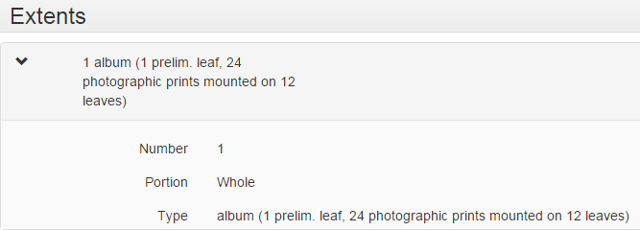
This string was automatically added to our “controlled” value list of Extent Types…
(= Hot Mess!)
Notes:
[Slide 14]
To fix this, we had to experiment a bit to find out how ASpace treated multiple extent statements. We found that it would parse the EAD until it found an extent statement which began with a number, and then would shoehorn that value into the Extent Number and Extent Type fields. Any additional extent statements would get dumped into the container summary text field.
Who wants to clean up that value list?!

Slide 15
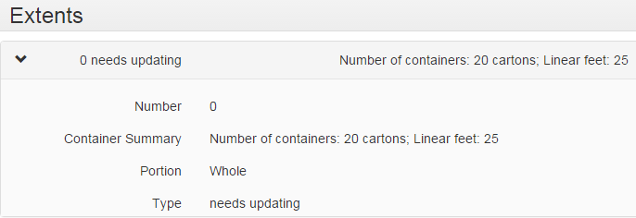
The Fix
<physdesc>
<extent> 0 needs updating</extent>
<extent>Number of containers: 20 cartons; Linear feet: 25
</extent>
</physdesc>
Notes:
[Slide 15]
Ideally, we would have the time and the staff to edit all of our legacy EAD to conform to the ASpace import requirements and to ensure our extent measurements are correct.
Practically, we need a quick-and-dirty fix which will allow us to move the EAD into ArchivesSpace where it can be reviewed, revised, and re-exported if needed. We just needed to give ArchivesSpace what it wants: a parsable <extent> statement with a number / type pairing. Once ArchivesSpace was happy, voila! A valid import. This preserves the container summary information without splitting it up and sticking chunks of it into the Extent Type value list. Of course, now we have to edit the Resource Record to record the actual extent of 25 Linear Feet in the appropriate fields, but that’s a manageable task for the amount of EAD files we have.

Slide 16
Success!
Notes:
[Slide 16]
Here’s a finding aid which has been successfully imported into ASpace. Note that the EAD importer and ASpace documentation/error reporting is improving with each new version, and we’re moving ahead with 28 additional EAD files recently imported into our testing instance ☺

Slide 17
It’s Not All About ASpace
Implementing a new collection management system is also about implementing change
Change from existing tools
Change from existing workflows
Change from existing policies
Notes:
[Slide 17]
This is the hardest part of implementing ArchivesSpace. Whether you’re a lone arranger, work in a small shop, or have dozens of coworkers, if your work involves collection management (and everyone’s does, at some level) then your work is going to change when you start using ArchivesSpace. I think it will change for the better- look at this slick intuitive tool which will help you keep track of all your information in one place! It’s web-based, so you can get to it anywhere, you can link related records together, you can move stuff around and export EAD and MARC.
But it’s different from what you’re used to. It’s also deliberately designed to give institutions a huge amount of flexibility in how they use it – ASpace provides the fields, you decide how to use them. There are recommendations and crosswalks with DACS, MARC, and EAD, but you can also build your own Classification scheme, customize the controlled value lists, add new Events, and create User Defined fields. So this requires everyone to agree on what fields to use and how, and that requires new policies and new workflows.
Ways to make this easier: include representatives from different areas in the discussion process. A manuscripts archivist and a cataloger are going to have different needs, and you need to know what those are and how to accommodate them. People aren’t going to use the tool the way you want them to if it doesn’t work for them. Take notes (minutes) of your discussions so you can remember what you all agreed on. Write clear, concise documentation for users to refer to. Hold open training sessions and demos. Encourage feedback, even if it’s negative. Ask people what a good workflow looks like.

Slide 18
“you’ll be all about ASpace: no trouble”
Your migration is only as good as your source data.
Form good partnerships and listen to people.
Learn about data mapping and/or seek help from technical staff.
Take the opportunity to review old policies and practices.
It’s only for now: change and improvements come often!
Notes:
[Slide 18]
So, with some preparation, you can be all about ASpace, ‘bout ASpace, no trouble.
The main thing for large custom migrations is to start with clean data and work according to the import specifications. Know where you’re going! Test and document.
Form good partnerships with the people who will use the tool and support the tool. Make friends with people in IT, or with people who can help with the more technical details of installation and upgrade.
Since development of the application is ongoing and community-driven, you’ll need to be prepared to be flexible and responsive to change- and reach out to the ASpace team and to other members/users for support.

Slide 19
Questions?
Kate Tasker, The Bancroft Library, UC Berkeley
ktasker@library.berkeley.edu
510-643-2886
@kate_tasker
ArchivesSpace Users Group Listserv Archives:
http://lyralists.lyrasis.org/mailman/listinfo/archivesspace_users_group
NASA Interns “All About That Space” Parody:
https://www.youtube.com/watch?v=kHy08ZPav88
Notes:
[Slide 19]
You’re welcome to contact me directly with any questions, or if you’d like to see our draft user documentation. Thanks!

