Slide 1
A Tale of Two Instances
Emily Vigor
Collections Archivist
Environmental Design Archives
UC Berkeley
Notes:
Today I’ll be talking about our experience using ArchivesSpace

Slide 2
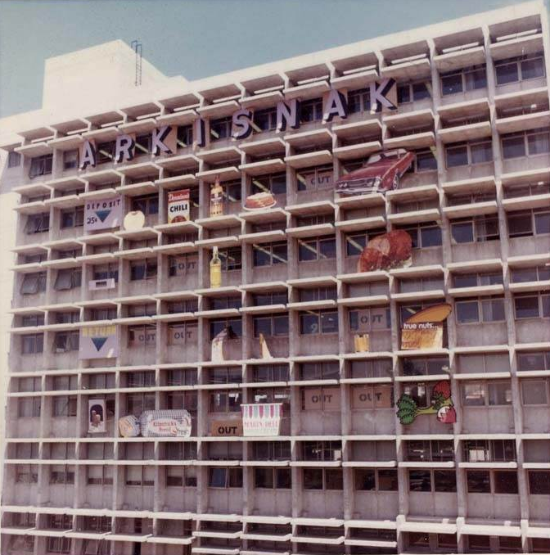
Environmental Design Archives
Design heritage of
N. California
200+ Collections
Affiliated Library
Archisnack, Wurster Hall as vending machine
Notes:
The EDA holds more than 200 collections documenting the architectural and landscape heritage of Northern California
Within the UCB campus structure, EDA in a unique situation as we’re an affiliated library (8 total)
Not part of main library
we weren’t involved with initial discussion to join Aspace
We’re not under the support of the Library IT ; our software either managed by campus IT or local departmental IT

Slide 3
Collection Management Tools
Notes:
Prior to Oct 2012, no collection management software in place
Curator created detailed spreadsheets that included all relevant information throughout their processing stages
Previously encoded finding aids by hand or using a Microsoft Access template the Bancroft Library had shared with us
Nov 2012 - I participated in a webinar training for ArchivistsToolkit – just in time to find out that Aspace was on the horizon
We decided to implement AT though to get familiar with using a collection management tool
Opted to use California Digital Library hosted instance
We were able to successfully encode 3 finding aids using AT during that first year
We decided to hold off on trying to import legacy records until we knew more about Aspace

Slide 4
ArchivesSpace - Pilot Program
Hosted ASpace instance
For UC Libraries and UC affiliates
6 month trial period
Notes:
October 2013 – Contacted by Adrian Turner at the CDL to see if we would like to participate in a pilot program to test if CDL would be able to host Aspace
Would be offered UC Libraries and UC affiliates only
We decided to include ourselves as we were eager to participate and move our finding aids into a collection management system
January 2014 – CDL Aspace pilot program launched with a commitment to a six month period (Jan-June 2014) CDL would monitor and evaluate resources and level of effort required to establish and maintain the instances
Once our instance was established, Adrian sent us all a quick start for instructions to use the software
Because CDL was not an institutional member, we did not have access to more detailed instructions

Slide 5
Implementation
Legacy records
Validation issues
Exportation issues
Stop and reflect
Notes:
Excited to start, and automatically try to import all of our legacy finding aids from files grabbed off the OAC
Half validate and half don’t, likely due to DACS requirements that our old finding aids didn’t comply with
Ones that did validate in Aspace have issue of extra coding being added to Aspace fields when importing legacy records. Also issue of some EAD output not getting reflected when exporting from Aspace, so the finding aid won’t validate on the OAC
These were issues that we let the Aspace developers know about
Stop and reflect on next steps

Slide 6
Next Steps
Training
Planning
Community
Internships
Notes:
Realized we needed some more detailed training
May 2014 – coworker and I took part in a 2-day Aspace training with Brad Westbrook and Adrian Turner at UC Berkeley
Incredibly useful, live demonstration is helpful as someone who is more visually oriented
Also introduced us to the community on campus that would be using this tool which included members of both affiliated libraries and the main library
Helped us figure out our next steps

Slide 7
Accession Records
Notes:
Accession records
Reference Archivist Chris Marino used a CSV template provided by ASpace to load our accession records

Slide 8
Accession Records
Notes:
Once we loaded the CSV file into Aspace, our accession records were automatically propagated for us
Were able to spawn resource records from these accession records
This means that these two records are digitally linked to one another, and is helpful for us if we ever need to look back at the origin of a collection

Slide 9
Next Steps
Planning
Internships
Notes:
Since we have a relatively small number of finding aids, we decide to manually enter our finding aids into Aspace – gives us a good chance to clean up legacy data and make our finding aids cohesive
One of the ways we thought we would tackle this was to put out a call for interns to work with this tool
Were fortunate enough to have a SJSU MLIS student intern with us and enter legacy records into Aspace for a semester this year
Good experience for them as a marketable skill when looking for jobs, and a great opportunity for us to work through this backlog
Which instance to use – CDL or UCB?
Would we be able to migrate from one Aspace to another?
Would UCB library IT be able to support us?

Slide 10
Instances
Notes:
Were provided an UCB hosted instance in Fall of 2014
Our instance was shared with several affiliated libraries on campus; could only be done this way as that’s all the main library IT could afford financially and staff wise to manage
Each had our own account with the instance to set up staff and work on our records
Issues
We could see and edit each others records when at the system administrator level
Non EDA staff names appearing in our users list
Subject and name authority files
How to ingest legacy records into correct repository?
Example: one library in our shared instance has around 500 legacy records that they want to import into Aspace. There is no way for them to designate that they want them to ingest into their repository. They could ingest into our repository. We haven’t tested this out for fear of having to clean up a lot of data.
We discovered that this was due to an incorrect installation of Aspace by the IT department and could be resolved
It was enough of an issue though that many of us have opted to work with CDL or with our own departmental IT to maintain our own Aspace instance

Slide 11
Instances
Califa to help negoatiate affordable group pricing for ArchivesSpace hosting with Lyrasis
Contact Tonya Holliss (thollis@sfsu.edu) if interested
Notes:
CDL recently decided they will be unable to host Aspace outside of UC Libraries and affiliates
Email from Tanya Hollis on August 4
A number of Bay Area institutions have begun to explore transitioning from Archivists’ Tooklit to ArchivesSpace. Rather than each institution working on its own hosting solution, they have decided to work with Califa, the statewide California library consortium, to negotiate affordable group pricing for ArchivesSpace hosting with Lyrasis, as they believe that Lyrasis can offer the user support they don’t have within their home institutions.
Email sent extends an invitation for other California institutions to join, with the hope that a large number of initial participants will increase Califa’s negitiating power
Were hoping to hear from all interested institutions by August 15, but can still try to email Tanya Holliss at thollis@sfsuedu if interested

Slide 12
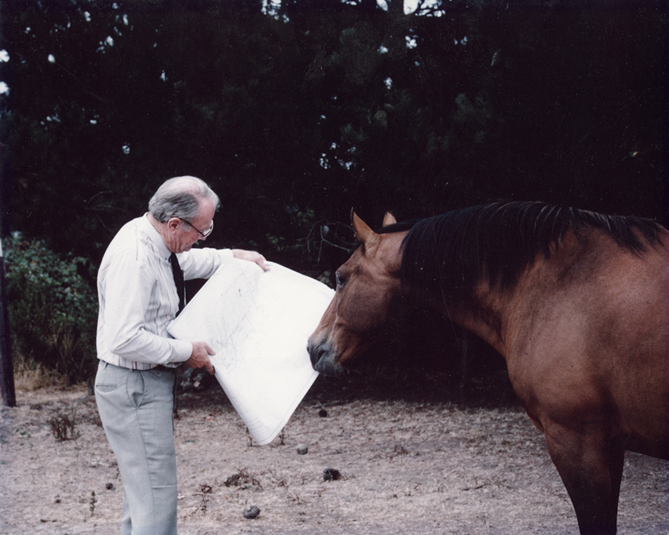
Lessons Learned
Planning
Patience
Collaboration
Flexibility
EDA images: Landscape architect Robert Royston showing his designs to a horse
Notes:
Lessons learned and future plans
Take the time to plan our your implementation and steps, rather than just jumping in
Will help you from having to repeat work later down the road
Patience in key – when you’re the guinea pig for new software, you need to be prepared for some bumps in the road
Collaboration – since there are numerous libraries using ASpace, try to work together to figure out problems, share ideas, and just get to know each other. It makes a large institution feel much more human. If you’re in a repository that’s more singular, there’s also a very active listserv
Flexibility – This software is still fairly new and there are still issues with each update. Need to be flexible as the software moves forward, but overall it’s a very useful tool for us

Slide 13
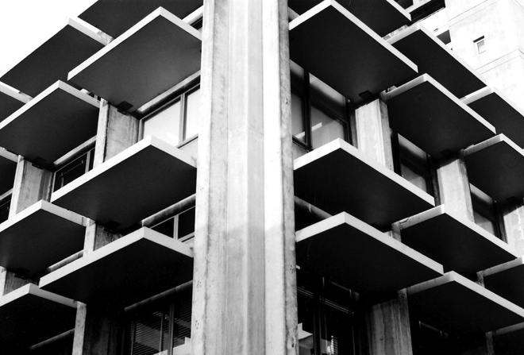
Thank You!
Emily Vigor
Collections Archivist
Environmental Design Archives
UC Berkeley
evigor@berkeley.edu
edarchives
EnvironmentalDesignArchives

