Slide 1
Engine or Caboose: The Changing Relationship between Archives and Records Management
November 4, 2014

Slide 2
Introductions and Overview
Leslie R. Fisher, MLIS, CLIS
Records Retention Manager
San Francisco Public Utilities Commission
Sydney Bailey, Archivist
California State Archives

Slide 3
Records Management
The field of management responsible for the efficient and systematic control of the creation, receipt, maintenance, use, and disposition of records.
Records must be managed in a consistent and meaningful way so they are complete, unaltered and available to those and only those users authorized to access them throughout the record life cycle.

Slide 4
The Record Lifecycle
  Creation (creation or receipt AND declaration)
  Use / Maintenance (regulation of storage, access and distribution)
  Inactive Preservation (a record no longer needed to conduct active business, but with ongoing value as evidence)
  Disposition (destruction, transfer to another entity, or permanent preservation)

Slide 5
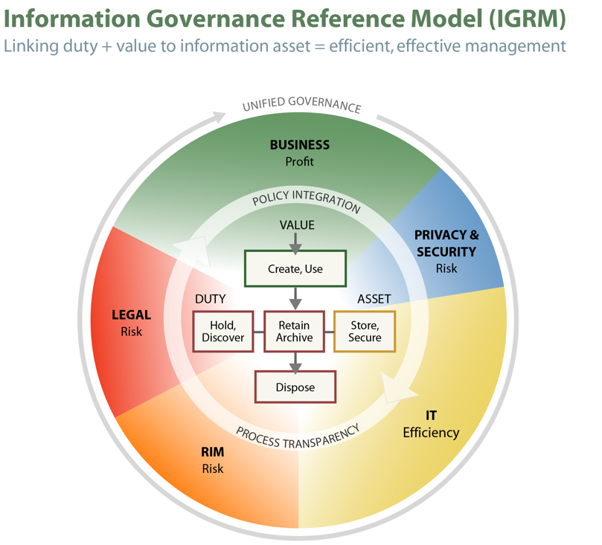
Information Lifecycle Management
Developed by the team which developed the Electronic Discovery Reference Model
NOT aimed solely to build out the Information Management node of EDRM
NOT prescriptive; a reference to promote cross-functional collaboration
Extensible in numerous directions, such as RIM, compliance, and IT

Slide 6
Record Classification
Record classification is applied according to the type or subject matter of the record rather than format.
A record can be a tangible object or digital information. For example:
a birth certificate
a driver’s license
medical x-rays
a photograph
a sound recording
a completed application
an engineering drawing
office documents
database contents
an e-mail msg or thread

Slide 7
“What is a Record According to ISO”
Per International Standards Organization:
… information created, received, and/or maintained as evidence by an organization or person, in pursuance of legal obligations or in the transaction of business

Slide 8

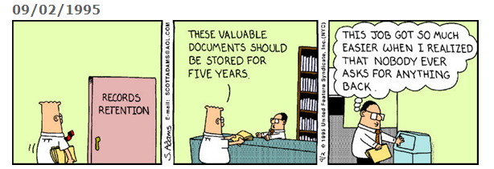
Records Management According to Dilbert

Slide 9
The Basic Business of RM
Records are any form of business documentation which the organization preserves because…
It has a Legal Obligation to do so
This documentation is Essential to the conduct of Business
It carries Historical Relevance
Reference documentation is usually not a record, but may be highly useful, and thus relevant to preserve for a short or long interval.

Slide 10
Information Management
What is NOT a record
… meeting notes of individual participants; factual data from third parties; temporary information, such as notations or post-its; draft documents; duplicates; personal notes; etc.
… to be destroyed at the earliest opportunity

Slide 11
Information Management Policy
SFPUC recognizes that SFPUC’s recorded information is a valuable organizational asset and will be managed in a manner that:
Ensures its quality and integrity
Ensures its organization and classification
Safeguards designated information against unauthorized access
Protects essential information against loss
Eliminates unnecessary duplication or collection of information

Slide 12
SFPUC’s Records Management program
The San Francisco Public Utilities Commission has devised a Record Retention Policy, including a Record Retention Schedule, pursuant to Chapter 8 of the San Francisco Administrative Code, which requires each department head to maintain records and create a records retention and destruction schedule.

Slide 13
RM Policies
Records are classified according to an approved Record Retention Schedule
A Record Retention Schedule defines specific record types maintained by an organization and identifies the retention periods (life cycle duration) for each class / type
Retention may be based on legal or regulatory requirements, standards, best practices or company definitions

Slide 14
RM for the New Employee Orientation
Records Management – What you Need to Know
  Relevance
  Basics
  Record Retention Schedule
  Legal Holds
  E-mail management
  Records Management - employees activities

Slide 15
Relevance
Retrievability and Security of your work
  For current projects and activities
  For future development, repair, re-design of our assets (long-term assets)
Accountability to our customers
Effectiveness and Credibility of the organization
Limiting potential liability to the organization
Limiting potential liability to self

Slide 16
RM Basics
Records Management – “What is it?”
What is a Record?
What is NOT a Record?
Records Coordinators
Records Management Resources on “Currents”

Slide 17
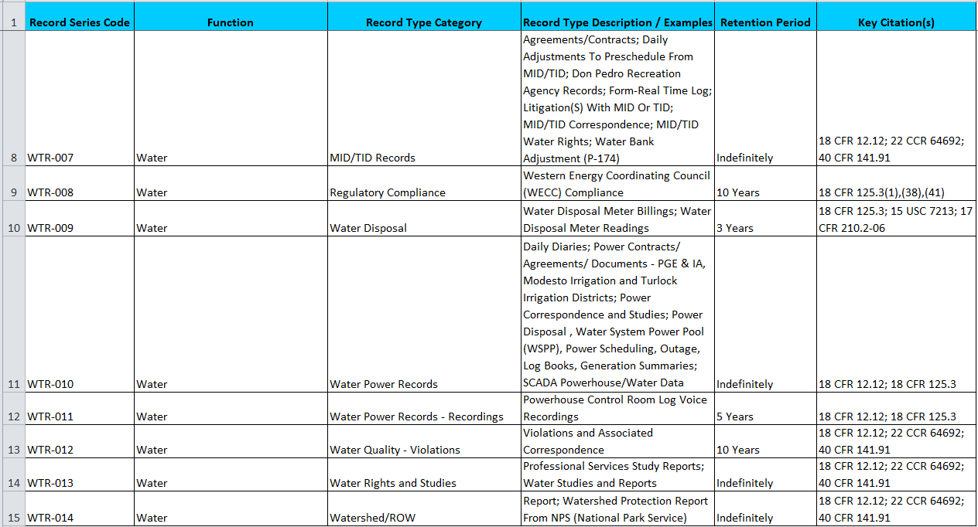
Sample from SFPUC Record Retention Schedule

Slide 18
Retention Requirements
Some SFPUC records have fixed-term retention periods
  I.E. are retained for X number of years from the year of creation
Other SFPUC records have event-based retention
  the annual count-down does not begin until a triggering event (such as end of employment, project or contract)
Many SFPUC records have Indefinite Retention

Slide 19
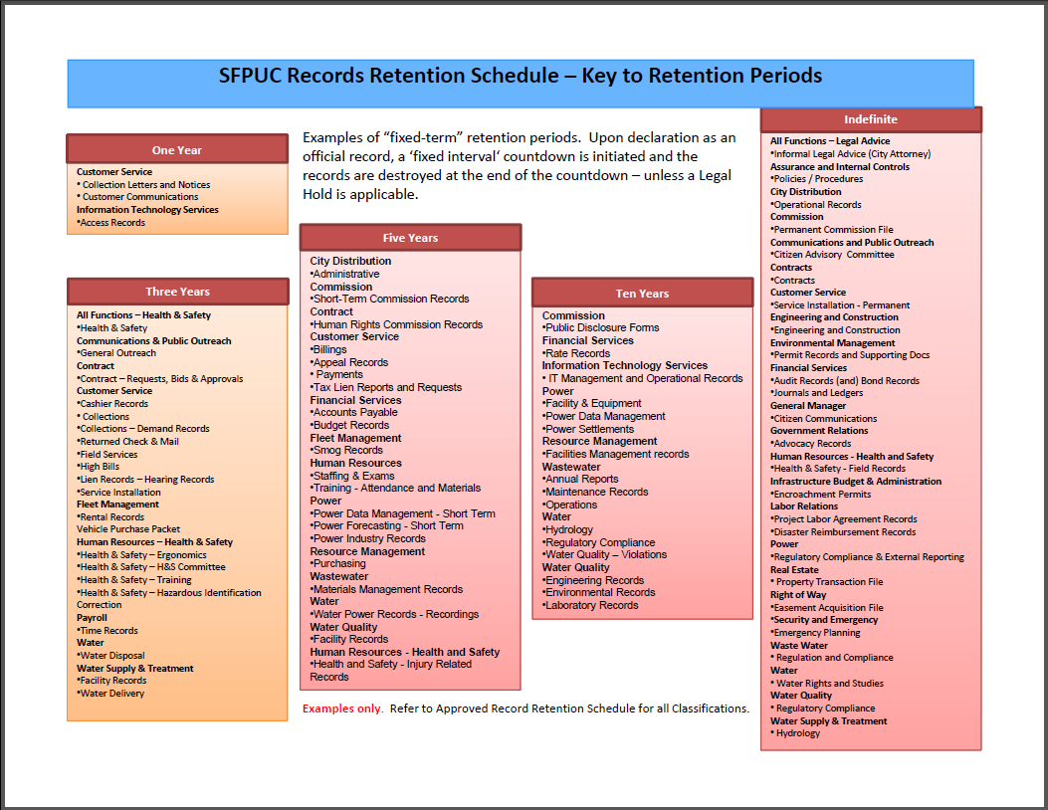
Records Retention – Fixed-term

Slide 20
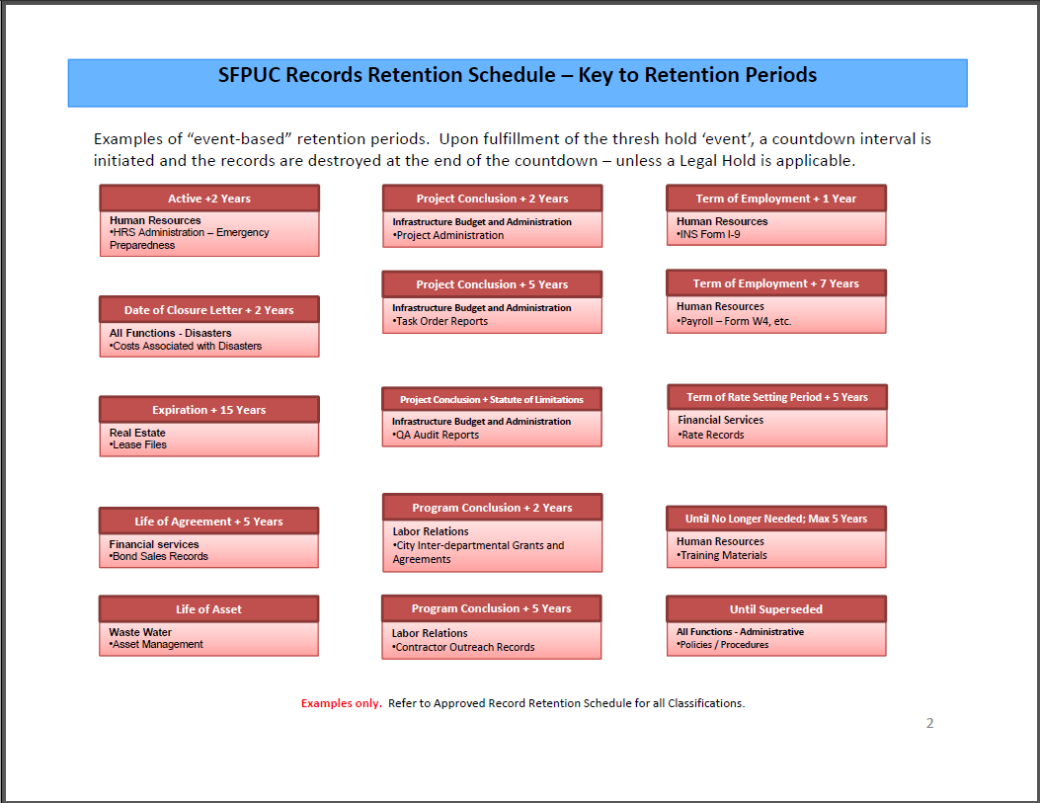
Records Retention – Event-based

Slide 21
Records Management and the Employee
Compliance with the Record Retention Policy is subject to review and audit by the SFPUC Records Management Organization.
Willful or negligent destruction of documents, in violation of the requirements in the Schedule or of active Legal Hold requirements, may result in disciplinary action, up to and including termination of employment and possible criminal prosecution.

Slide 22
Legal Holds
“Legal Hold” – a response to active or anticipated, litigation, investigation or audit
  Records subject to a Legal Hold must be preserved
  Record destruction must be suspended
Employees are accountable for compliance with LH
  Generally applicable to specific individuals
  Notifications received from City Attorney
  Applies to work-related information in any location
    (your office, computer systems, offsite storage, your home, etc.)
Failure to comply can result in penalties to agency and employees

Slide 23
Organizational RM Events
Training (under development)
  Annual, mandatory online training
    15-20 minutes to complete
    Will be assigned to you in the Learning Management System
    Will be certified
Records Cleanout Day
  Sanctioned by Executive Mgt
  Opportunity to review onsite records for purge or submission to offsite storage
  Annual event
  Departmental certification

Slide 24
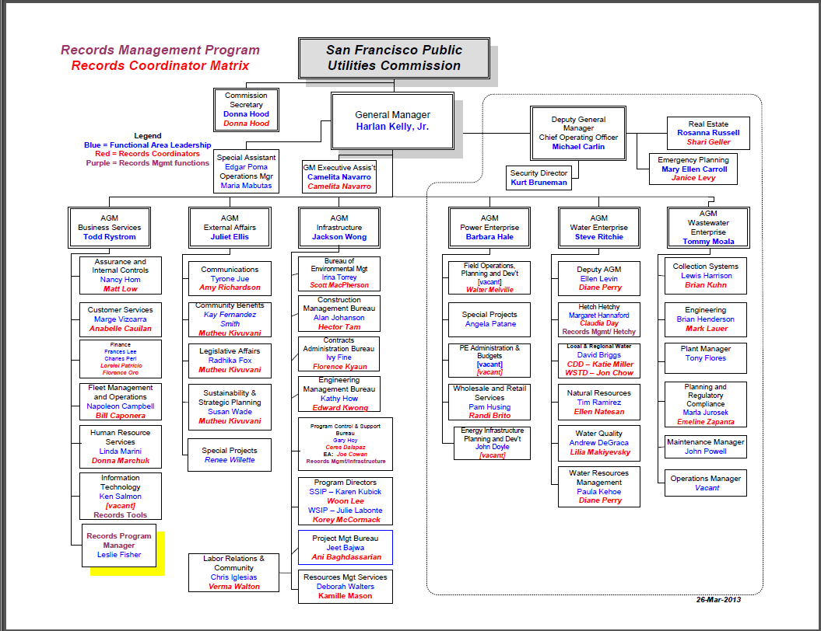
Business Unit Records Coordinator

Slide 25
The Role of the Records Coordinator
Primary liaison between the functional area and the Records Program Manager
Assigned within each functional area
The lead within their team for promoting Records Management (RM) compliance
Will facilitate Records Clean-out Days, Record Disposition review, Retention Schedule update, etc.
Records Coordinators are to maintain an understanding of the RM policies and procedures.
When a Records Coordinator leaves the position, or the RC role is re-assigned, the RC should notify the Records Manager of such changes.

Slide 26
Three pillars of RIM risk management
Record Lifecycle Management
eDiscovery Responsiveness
Vital Records Protection

Slide 27
Why Lack of Information Lifecycle Management is a Risk
Information assets will be lost, corrupted, or unreasonably exposed
We will be unable to respond to an emergency, emerging situation, negotiation or opportunity
We will be damaged by being unable to show proof of compliant activities / behaviors
Credibility – of the agency and its management – will be lost due to exposure of the above
Financial woe may result from any of the above

Slide 28
eDiscovery as a Risk
Electronic discovery is a reference used in civil litigation referring to a formal, step-wise manner of identifying, analyzing, preparing and exchanging information in electronic format.
  (often referred to as electronically stored information or ESI).
The exchange of these data are subject to Federal and State law, and legally binding and negotiated processes.
  Federal Rules of Civil Procedure

Slide 29
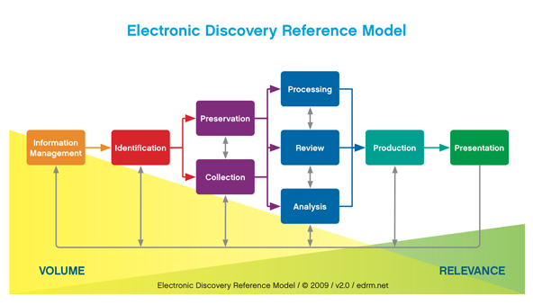
EDRM
conceptual view of the e-discovery process, not a literal, linear or waterfall model
an iterative process; repeat & hone, cycle back, etc.

Slide 30
Vital Records
“Information in vital records may not be replaced at any cost or would cause grave business consequences, such as loss of customer base or production capability. Vital records are typically 2-7% of an organization’s records.”

Slide 31
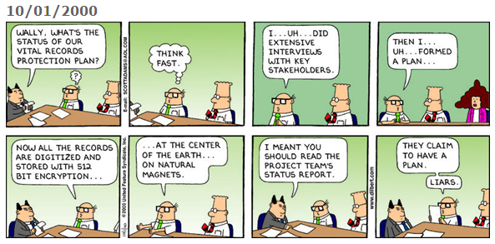

Slide 32
Vital Records Risks
Vital Records: Vital records are those records that are required in order to:
(1) continue operations or resume operations after a disaster,
(2) establish the agency’s legal identity and/or rights,
(3) establish or prove the agency’s financial position,
(4) protect the agency from large financial loss resulting from legal action, fines, or the inability to collect monies due,
(5) prevent shutdown resulting from the inability to document compliance with regulatory requirements, or
(6) preserve the rights of the agency’s, its employees and shareholders.

Slide 33
Triggers to RM Risks
An inaccurate accounting of the records generated or maintained by the agency (RRS is wrong or inadequate)
Records are not recognized by the business owner
Records are not properly classified
Records are not retained according to the RRS
Quality Assurance for Information Lifecycle Management is not applied
Willful theft, spoliation or exposure of sensitive records by disgruntled employee

Slide 34
Consequences of Risks
Danger / harm to employees and/or public
Lack of ability to proceed with development, growth, improvement
Financial loss, lack of financial gain
Damaged reputation

Slide 35
Mitigation Strategies
Regular Review / Revision of the RRS
Plotting of Vital Records into RRS
Vital Records Protection Program established
Ongoing education about Records Management
Data Map of agency content
Record-keeping compliance Audit
RIM responsibilities tied to performance
Awareness campaign on Legal Holds
Identification of skills / capabilities for in-house collection
Protocols developed for interactions with City Attorney contacts

Slide 36
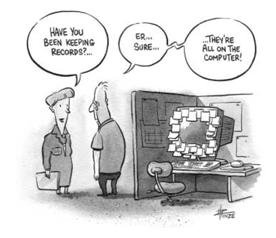

Slide 37
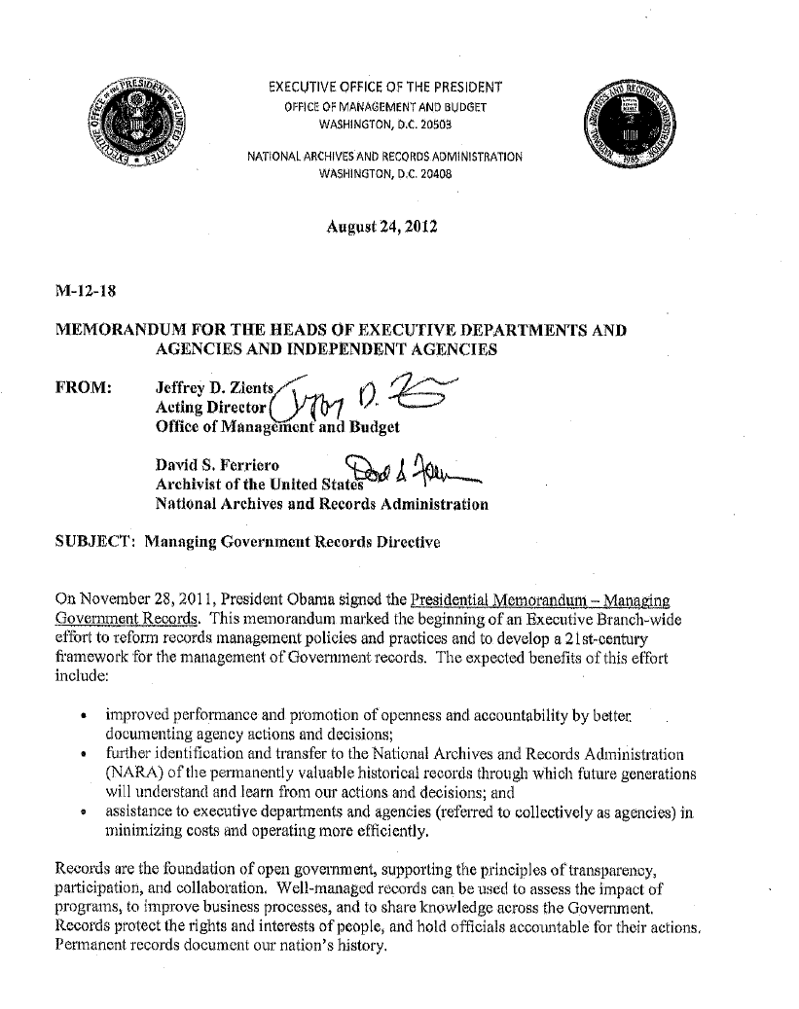
Federal
Government:
National Archives
And Records
Administration

Slide 38
State Records Management Act
[Govt. Code 12270 – 12279]
12272.
(a) The Secretary of State shall establish and administer a records management program that will apply efficient and economical management methods to the creation, utilization, maintenance, retention, preservation, and disposal of state records.
(b) The duties of the Secretary of State shall include, but shall not be limited to:
  (1) Establishing standards, procedures, and techniques for effective management of records.
  (2) Obtaining from agencies reports required for the administration of the program.
(Added by Stats. 2014, Ch. 28, Sec. 24. Effective June 20, 2014.)

Slide 39
Local Government
The State Records Management Act does not apply to local government, county and/or city government agencies.
There is no standardized program of accountability for treatment of public records on the local level of government.
Nor does local government have standard retention periods for various record categories other than certain record types identified in government codes that mandate specific local programs.

Slide 40
Secretary of State – Local Government Records Program
Created in 1999 (Govt. Code, section 12236)
Function is to provide guidelines to help provide standards and structure, but does not establish retention periods or records retention programs for local government

Slide 41
RRS Benefits
Organization hierarchy
Series descriptions
Series titles
Contact information
Quantity
Format
Legal Restrictions
other

Slide 42
Appraisal - Definition
Appraisal: n. ~ 1. The process of identifying materials offered to an archives that have sufficient value to be accessioned. - 2. The process of determining the length of time records should be retained, based on legal requirements and on their current and potential usefulness. - 3. The process of determining the market value of an item; monetary appraisal.
(Society of American Archivists, Glossary of Archival and Records Terminology, 2005, by Richard Pearce-Moses)

Slide 43
Appraisal - Archival Values*
Primary Values:
Administrative, Legal, Fiscal
  Generally speaking, primary values become less important as time passes, although this is not always the case. Records with still important primary values are usually still active and have not yet reached the end of their approved retention periods.
  Examples: Audit reports, Policies and Procedures, Legislative records, Minutes, Investigative files, Warrant registers.
*per Theodore R. Schellenberg

Slide 44
Secondary Values:
Evidential and Informational
  These two values are the principal concerns of archivists. Evidential values are those used to "determine the organizational structure of an institution, document its procedures, policies and activities, and evaluate its effectiveness." Informational value is placed on those records that have information about "persons, places, subjects, and things other than the operation of the organization that created them. Informational values in records are used for studies concerning historical events, social developments, or any subject other than the organization itself.“
  Examples: Minutes, Press Releases, Case files, Licensing Files

Slide 45
Intrinsic Value
The usefulness or significance of an item derived from its physical or associational qualities, inherent in its original form and generally independent of its content, that are integral to its material nature and would be lost in reproduction.
Notes: Intrinsic value may include an item's form, layout, materials, or process. It may also be based on an item's direct relationship to a significant person, activity, event, organization, or place. Intrinsic value is independent of informational or evidential value. A record may have great intrinsic value without significant informational or evidential value; records with significant informational or evidential value may have little intrinsic value. The process of copying a document may sufficiently capture its informational or evidential value but fail to preserve some aspects of the material nature of the original - its intrinsic value - that merit preservation. Hence, documents with significant intrinsic value are often preserved in their original form.
(Society of American Archivists, Glossary of Archival and Records Terminology, 2005, by Richard Pearce-Moses)

Slide 46
Other Appraisal Considerations
  1. Provenance
  2. Original Order
  3. Completeness
  4. Authenticity and Reliability
  5. Format
  6. Cost
  7. Mission and Collection Policy

Slide 47
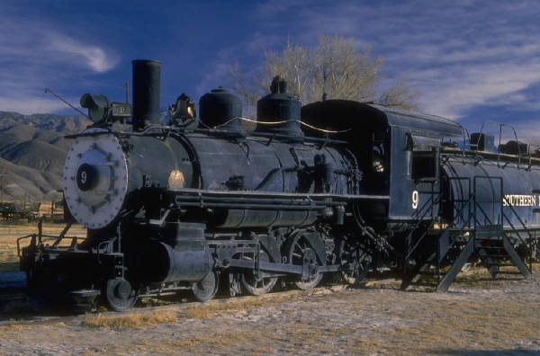
When Does Appraisal Take Place
  Are you the Engine, Caboose or something in between?

Slide 48
When to Appraise Records
1. When records are transferred to the Archives
  Accessioning
  Processing
2. When records are created
  Records Management
3. Before records exist
  Input into computer systems and standards

Slide 49
Appraisal Transferred to the Archives (The Caboose)
Accessions: First level of appraisal once materials are transferred to the Archives; Creation of an inventory.
Processing: Detailed appraisal; further understanding of the collection; creation of the finding aid.

Slide 50
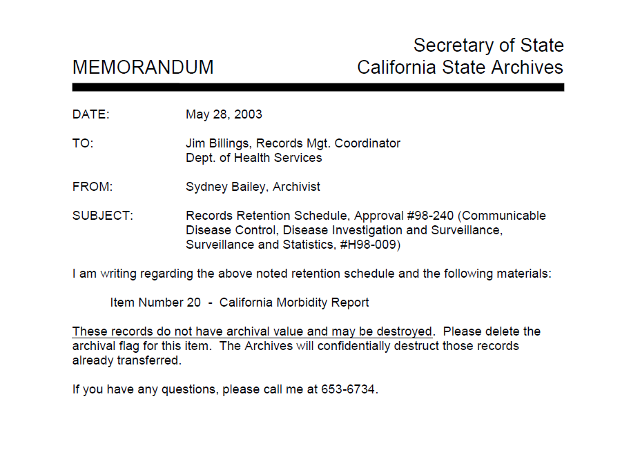

Slide 51
Appraisal when Records Are Created (Perhaps The Passenger Car?)
Supports Records Management function of scheduling active records
The archivist gains a better understanding of the entity creating the records and the records themselves.
Buy-In: The creator/user of the record gains an understanding of the value of the record that will eventually be transferred.
Further discussion of format and electronic systems

Slide 52
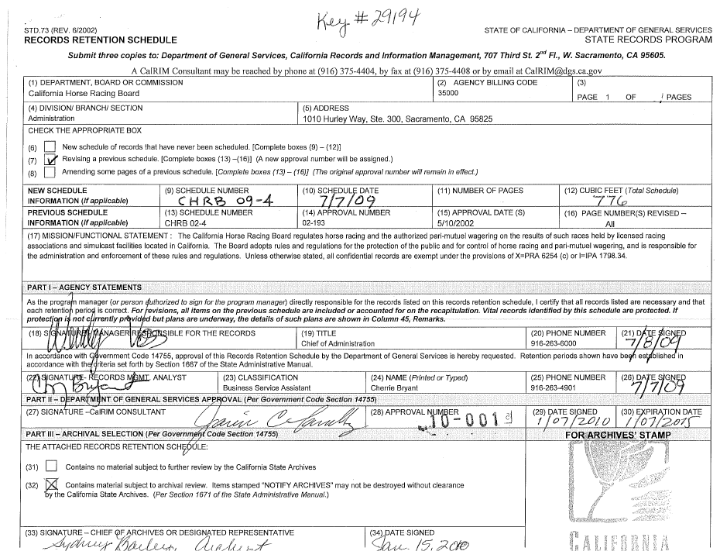

Slide 53
Appraisal Before Records Exist (The Engine)
  The archivist gains a better understanding of the entity creating the records and the records themselves.
  Supports Records Management function of scheduling active records
  Buy-In: The creator/user of the record gains an understanding of the value of the record that will eventually be transferred.
  Ensures that the records created are within a lasting medium and that a preservation plan is in place when records need to be migrated.
  Archives Budget

Slide 54
Electronic Records
The Cranky Two-Year Old
Born Digital or Digitized
Digital storage media has a short life and demands active management
Life of storage media is cut short by three factors
Media durability
Media usage, storage and handling
Media obsolescence
Trusted Systems/Digitization Standards
American National Standards Institute (ANSI)
Association for Information and Image Management (AIIM)

Slide 55

The Vocabulary
…Pixels, resolution, format, interpolation, bits and bytes, grayscale, RGB, file size, conversion, lossless, lossy, cross-platform, compatible, metadata, restrictions, privacy, access, users, cost, migration, security, backup, standards, file naming, hardware, software, proprietary, quality control, calibration, Tiff, JPEG,
PDF, PDF-A, Database, Dublin Core,
OCR, copyright/ownership….

Slide 56
Partnerships
  Managers
  Resource Providers
  Digitization Staff
  IT
  Records Creator and Users
  Records Manager
  Archivist

