Slide 1
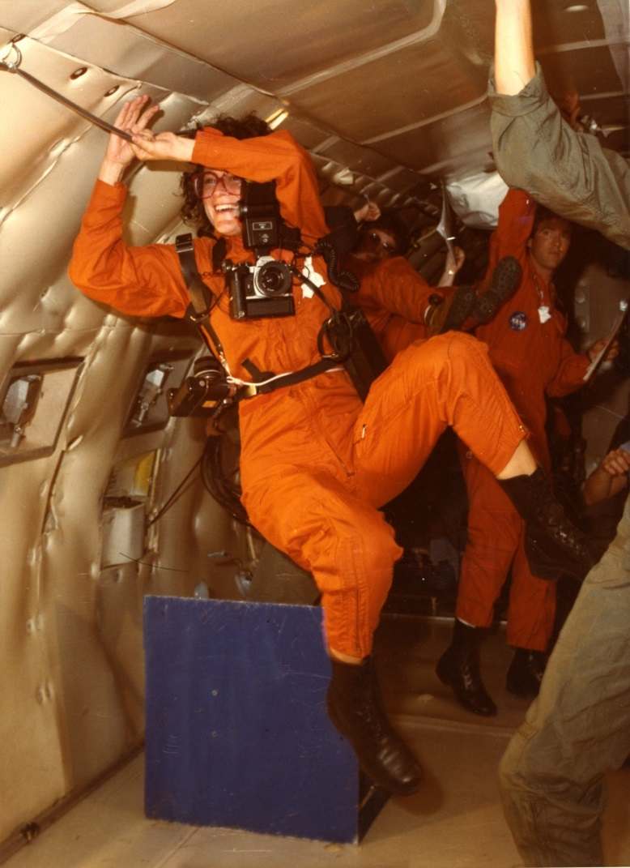
The Access Tightrope:
Society of California Archivists
Palm Springs, 2014
Notes:
Theo Westenberger in a zero gravity chamber while she was on assignment for a LIFE magazine story on the space shuttle in 1984.

Slide 2
Rights of Privacy and Rights of Publicity
The Theo Westenberger Archive, Autry Libraries, Autry National Center, MSA.25
Editorial, commercial and fine art photography 1970-2008
Donated to the Autry National Center in 2010
Currently being processed by Charlie Holland, Senior Archival Assistant
Neutra House, Altadena, 1971
Theo Westenberger Archive, MSA.25
Notes:
I came to the Autry as a volunteer after a career in the commercial and editorial photography business.
I had known Theo, worked with her, and shared many business acquaintances in New York and Hollywood.

Slide 3
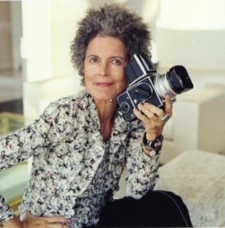
Theo Westenberger
Born 1950 and raised in Altadena, CA
1970-1979 shots architecture and gardens in Mexico, California and New York
1979-1985 at Look magazine, New York and shoots for European and national magazines, including Life
1985-2007 ‘Go to’ portrait photographer: politicians,
presidents, business leaders, designers, entertainers,
executives, sports figures, actors and musicians.
For magazines, design companies, movie studios
1995-2007 Travel photographer
2008 Passed away in New York City
Notes:
Her personality, exuberance, humor, excellent preparation and professionalism made her a popular photographer that picture editors could rely on.

Slide 4
The Collection
500 linear feet of archival boxes
Assignment files with photographs
Financial and business records
Tearsheets
Magazines
20 linear feet of photographic equipment
20 custom made photographers commercial portfolios
20 framed prints
50 posters, banner advertisements
Born digital photography 2006-2008
Books, now incorporated into the Autry Libraries
Electronic mail, financial records, business records 2000-2007
INCLUDING:
B&W negatives (35mm-5”x7”)
Polapan film
Infra red film*
Color negatives (35mm-6x7mm)
Color transparencies (35mm roll film -8”x10”sheet film)
Originals and duplicates
Inter-negatives
Laser prints
Contact sheets
B&W and color prints (4”x6” -30”x 40”), work prints, signed and limited edition prints
Hand-colored prints*
Printed promotional materials
*See next slide for examples
Notes:
Business records are primarily post 2000 except for her personal records about real estate properties and investments. This is our problem, we do not have the documentation that we know, from an intimate knowledge of the commercial photography business, should and did exist. These missing documents impact our ability to post or license her materials.

Slide 5
Technique: hand-colored prints(left) and infra red prints(right)
Turquoise, Los Angeles, circa 1970
Theo Westenberger Archive, MSA.25
Carport, Palm Springs, 1990
Theo Westenberger Archive, MSA.25.11.3A
Notes:
At left is a black and white print hand colored/painted with Marshalls Oil Colors and at right a print made from an infra red negative.

Slide 6
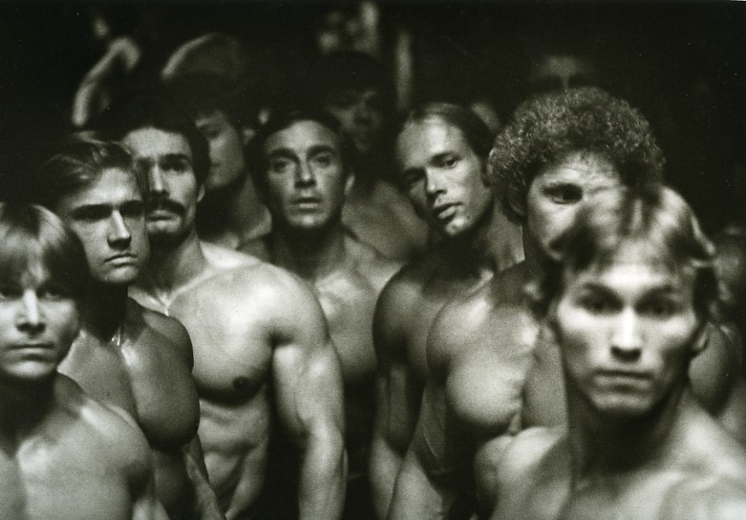
Real People
Blimp 3#, Rose Parade, Pasadena 1975,
Theo Westenberger Archive, MSA.25
Mr. America, Gold’s Gym, Venice 1977
Theo Westenberger Archive MSA.25
Notes:
Theo shot people and places, always assigned to jobs that suited her personality and ability to interact with anyone and everyone

Slide 7
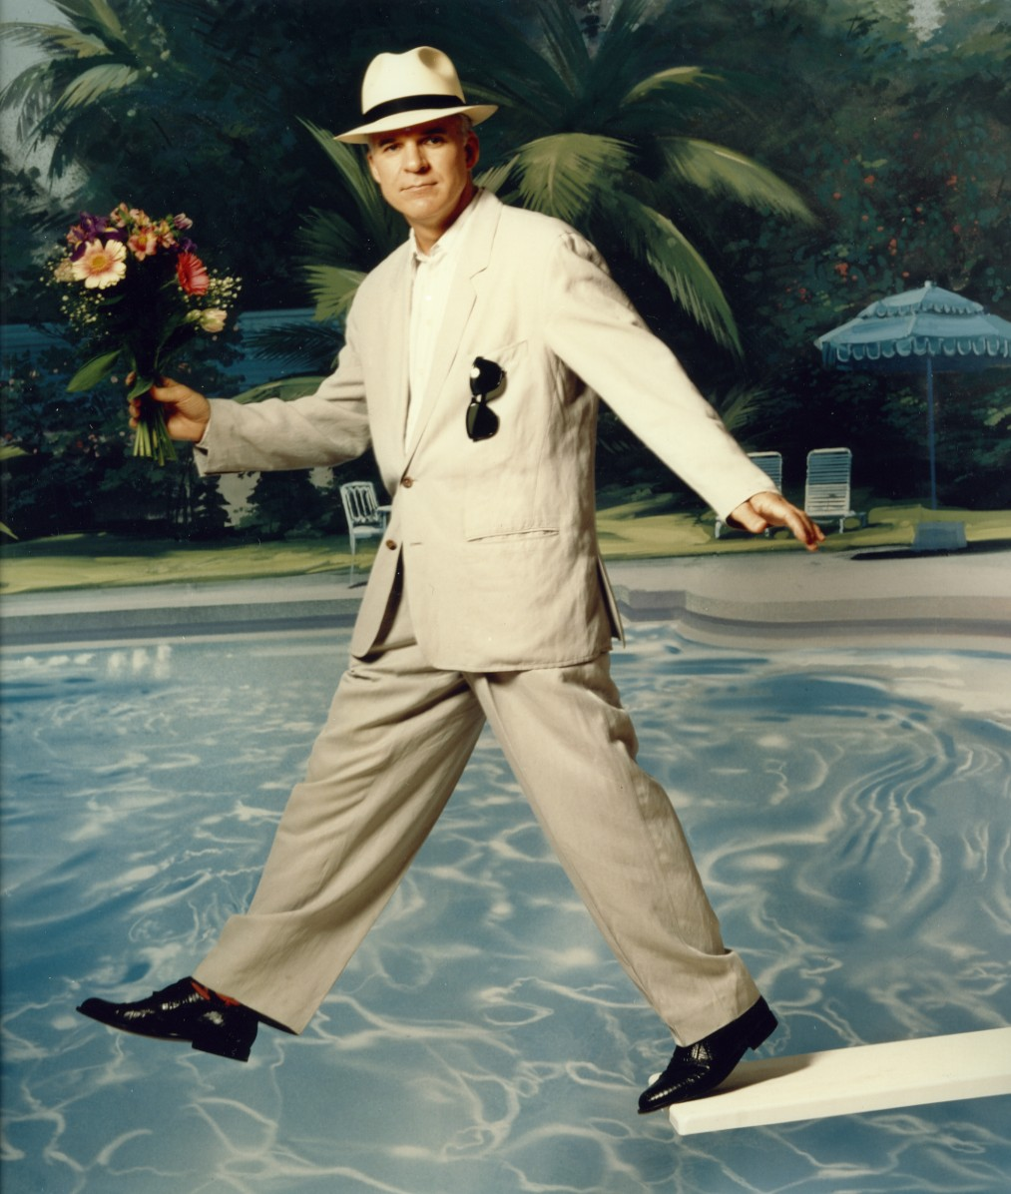
Celebrities
Steve Martin, 1991
Theo Westenberger Archive
MSA.25.6.
Notes:
Her energy and instant rapport with her subjects engaged celebrities and actors used to being directed and familiar with artifice.

Slide 8
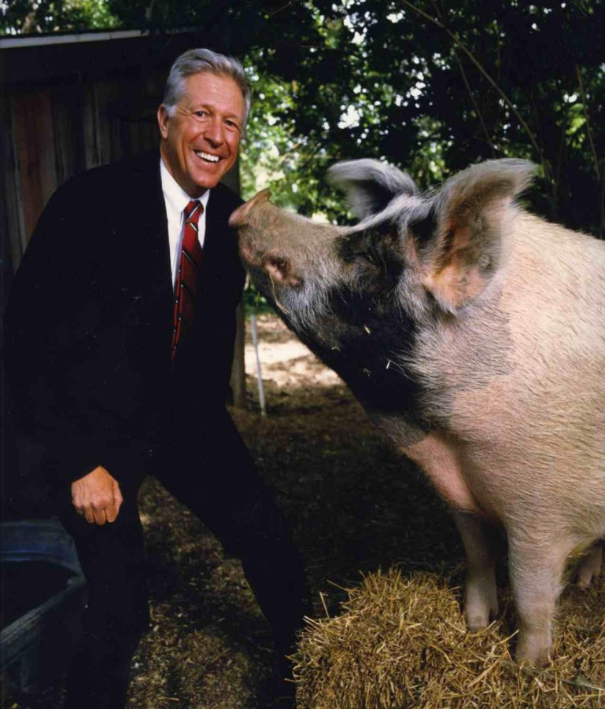
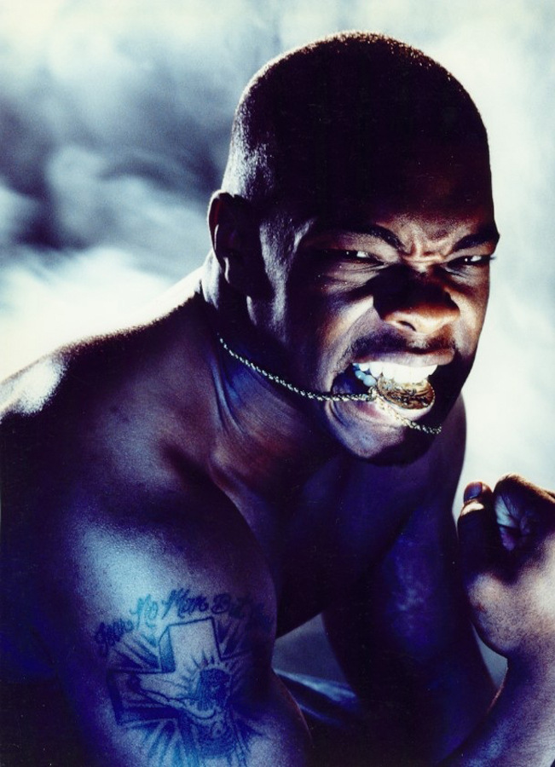
Sports Personalities and Businessmen
Leonard Little, for ESPN, 1998
Theo Westenberger Archive
MSA.25
Foster Friess, Kiplingers, 1994
Theo Westenberger Archive
MSA.25
Notes:
She was also adept at using lighting to add drama and not above adding a prop or two for visual effect!

Slide 9
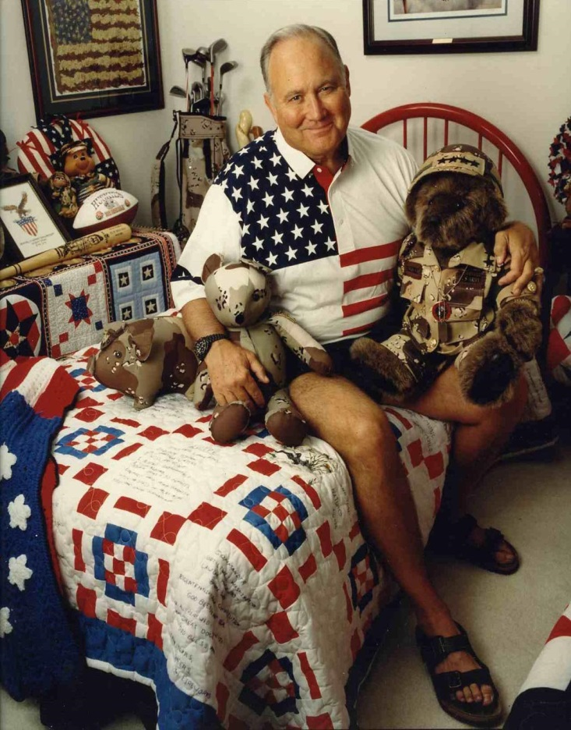
Heroes and everything in between
Norman Schwartzkopf,1992
Theo Westenberger Archive
MSA.25
Notes:
Even after extensive preparation she was always willing to use what she found, Schwartzkopf was photographed in a bedroom in his house and the Trumps asked to pose on their dining table.

Slide 10
The Access tightrope: Blending proactive enthusiasm
Blending unbridled enthusiasm
With informed caution
digitize it!
Upload it !
Use social media!
License it!
Develop a digitization policy
Understand the law
Read the fine print
Check your paperwork
Have a risk assessment policy in place
Notes:
The pressure to make the collection ‘accessible’ i.e. on line and visible in social media, has to be tempered by the reality of social media contracts, the high rate of theft on the internet, and the mores and practises of the celebrity photography business.

Slide 11
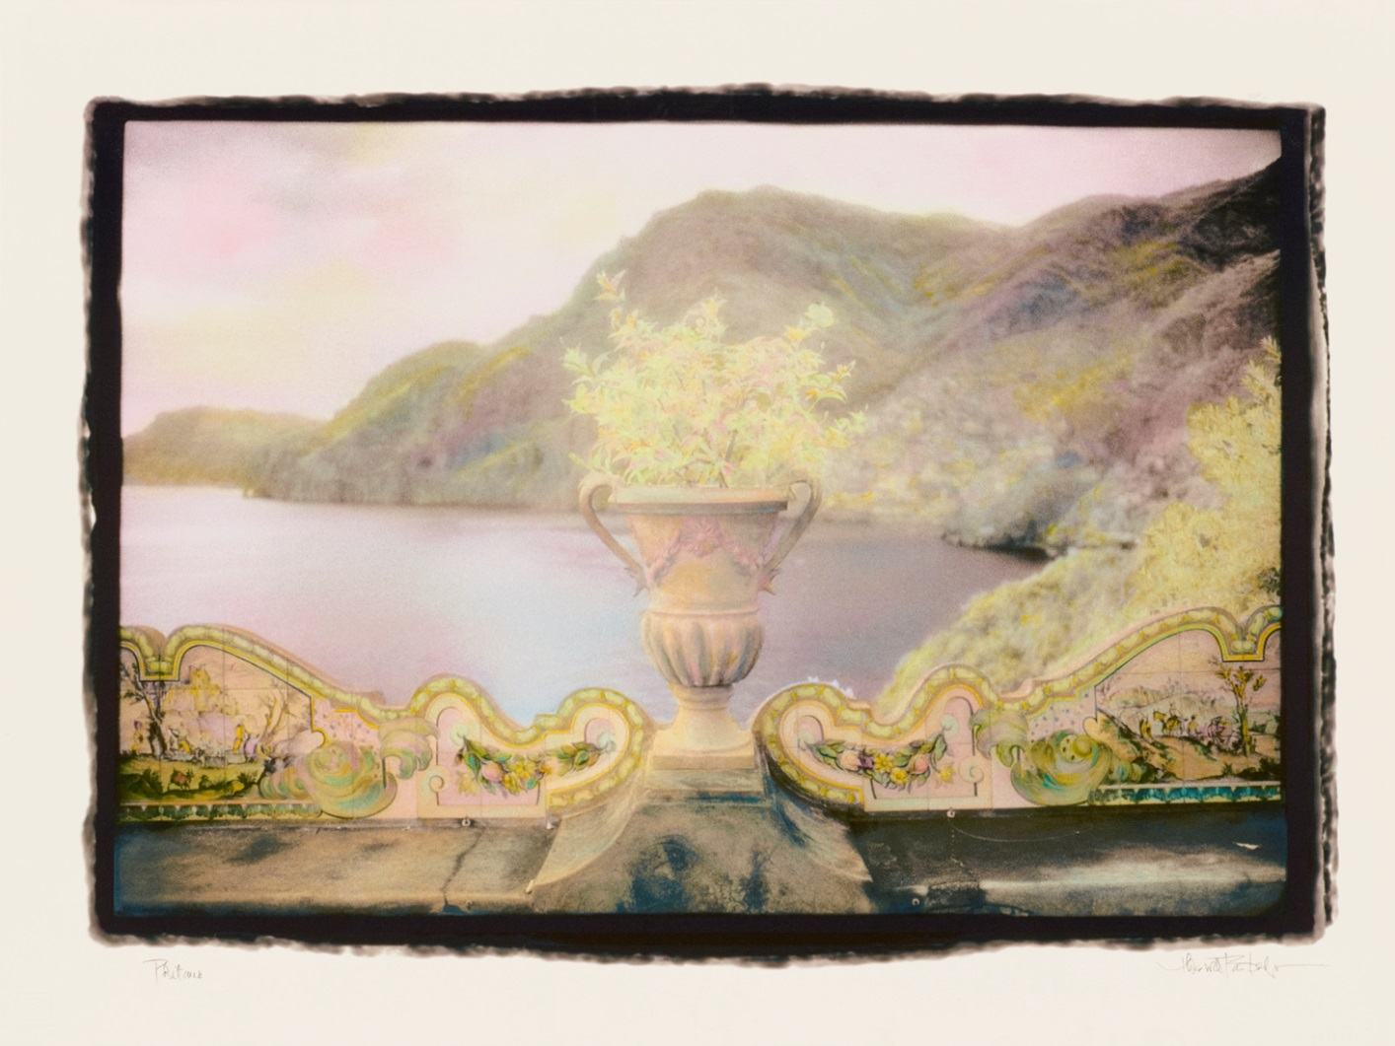
Digitization policy: Prioritize at risk items
Vase, Positano 1994
Theo Westenberger Archive
MSA.25.60.2A
Notes:
Our primary goal has been to digitize ‘at risk’ materials. This is a very ‘early’ 1994 fine art digital print made by Nash Editions which has been copied so a replica print can be made if the dyes start to change dramatically and the color changes.

Slide 12
Understand the law before you upload, market, promote, or grant digital access
Rights of Privacy and Rights of Publicity
The right to privacy primarily means the right of an individual to be left alone. Cases are brought on the basis of that right being invaded.
The right to publicity is the right of a well known person/celebrity to exploit their image or ‘persona’ for gain during their lifetime or after their death
Notes:
Two laws that have to be understood when you place your imagery in a commercial milieu, i.e. social media , agree to the image to be reproduced even in the editorial space or enter into licensing agreements with third parties.

Slide 13
Read the fine print:Facebook
https://www.facebook.com/legal/terms
You will not post content or take any action on Facebook that infringes or violates someone else's rights or otherwise violates the law.
You give us permission to use your name, profile picture, content, and information in connection with commercial, sponsored, or related content (such as a brand you like) served or enhanced by us. This means, for example, that you permit a business or other entity to pay us to display your name and/or profile picture with your content or information, without any compensation to you

Slide 14
Read the fine print: Instagram
you hereby grant to Instagram a non-exclusive, fully paid and royalty-free, transferable, sub-licensable, worldwide license to use the Content
your Content on or through the Service does not violate, misappropriate or infringe on the rights of any third party, including, without limitation, privacy rights, publicity rights, copyrights, trademark and/or other intellectual property rights
the Service is supported by advertising revenue and may display advertisements and promotions, and you hereby agree that Instagram may place such advertising and promotions on the Service or on, about, or in conjunction with your Content.
Notes:
Please note that they are able to reuse your image: a royalty free license to SUBLICENSE the work you upload – that means sell it. Also you guarantee that use of the images does not encroach on any one else’s rights. In doing so you indemnify Instagram from any lawsuits that arise as a result of your negligence with regard to rights infringement.

Slide 15
Read the fine print: Licensing at Art.com
Licensee shall also have the right to authorize third-party producers to manufacture
Licensor represents and warrants to Licensee that:
(commercial use) will not violate, misappropriate or infringe upon any copyright, trademark, proprietary right, right of publicity, privacy right, moral right, or other intellectual property right of any third party
Notes:
Marketing fine art through art sites such asa Art.com be aware that the material can be purchased for private use, as wall decoration, but that the site is used by manufacturers who purchase photography (or drawings, paintings etc) to produce goods such as mass produced pre-framed art work, coffee mugs, tee shirts, handbags, shower curtains etc. Again the wording includes your warranty that the art work is clear of any rights issues.

Slide 16
Privacy ( real people)
Rights of Privacy is the right to control the use of your likeness.
So when do you need a model release?
When the person is a minor
When the person is recognizable to others
When the person can recognize themselves, by appearance or context or distinctive features
When an image is used in a commercial context
Notes:
The law in action in your archive. You may
Appropriate : use a person’s photograph, or likeness for commercial purposes which damages the person’s dignity, interests and peace of mind
Shown that person in a false light: attributed an opinion or statement
Maliciously or falsely portrayed someone in a way that damages their reputation
Or disclosures private facts about the person shown
intrudes on your affairs, photographed at a private event or place you had the expectation of privacy

Slide 17
What must a model release show?
Picture of model
Date of birth
Witness to signature
Contact details
Description of shoot
Location and date of shoot
The most defensible model release is available at
www.gettyimages.com in 20 languages.
Notes:
As often as not model releases are used to prove who a claimant IS NOT. False claims are very common so you must collect the minimum information above to be able to double check someone is who they claim to be

Slide 18
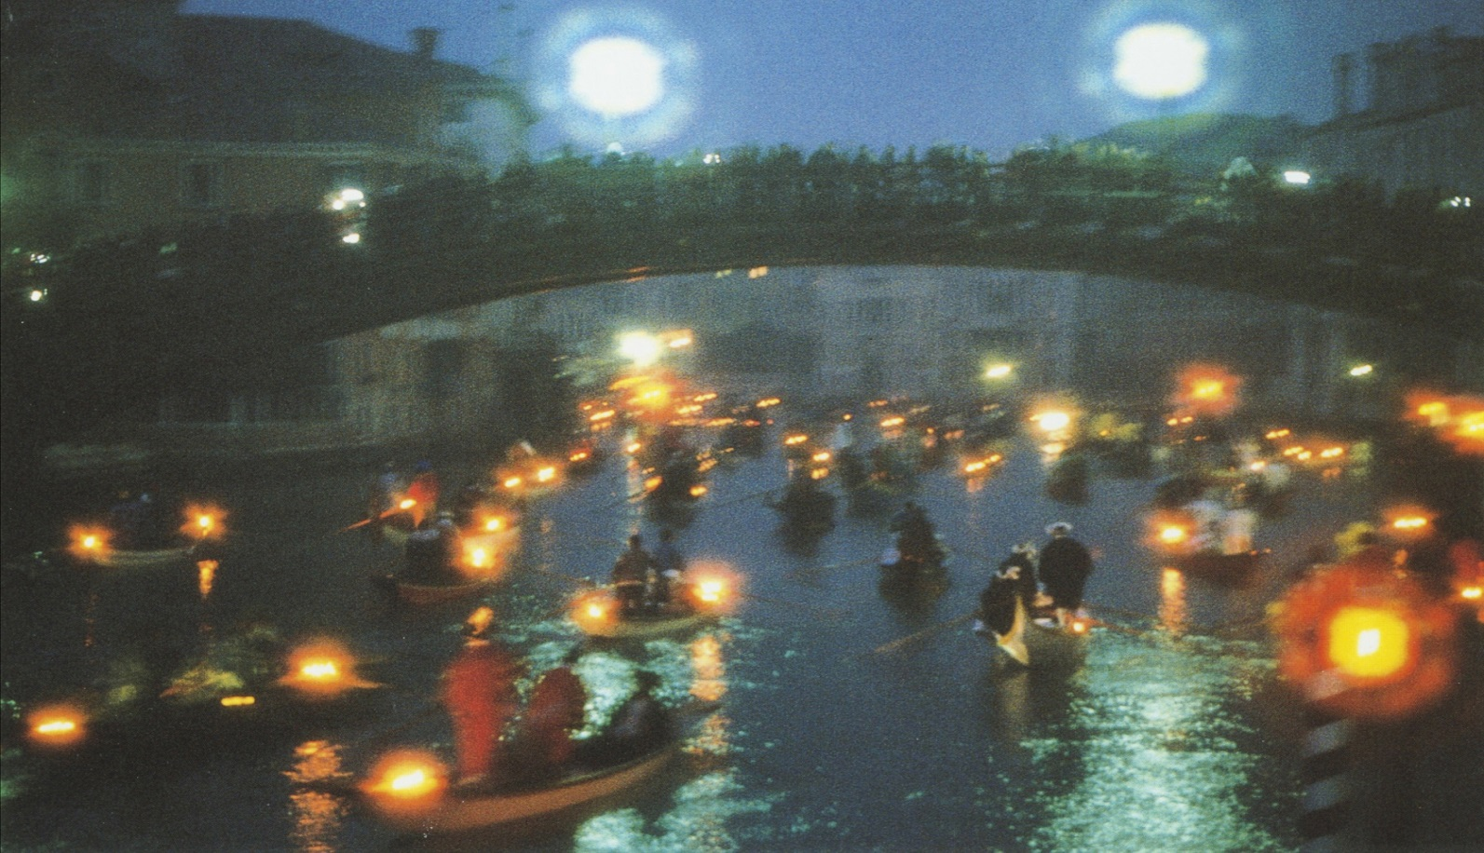
Risk Assessment : Venice Carnevale
image
Grand Regatta, Venice, 1996-1998
Theo Westenberger Archive
MSA.25
Notes:
Theo always loved a parade and for three years in the 1990s she photographed the Venice Carnevale. We wanted to digitize and possibly license these images – every image FULL of people. So we had to develop a risk assessment procedure.

Slide 19
Risk Assessment procedure:
If there are model releases:
Do met the legal criteria (or industry standard) i.e. are they defensible?
If there are no model releases:
Are the persons known?
Are the persons indistinguishable and wearing costumes that are generic?
Are persons distinguishable and recognizable to themselves and others?
Are the costumes unique works of art ?
Notes:
Risk assessment

Slide 20
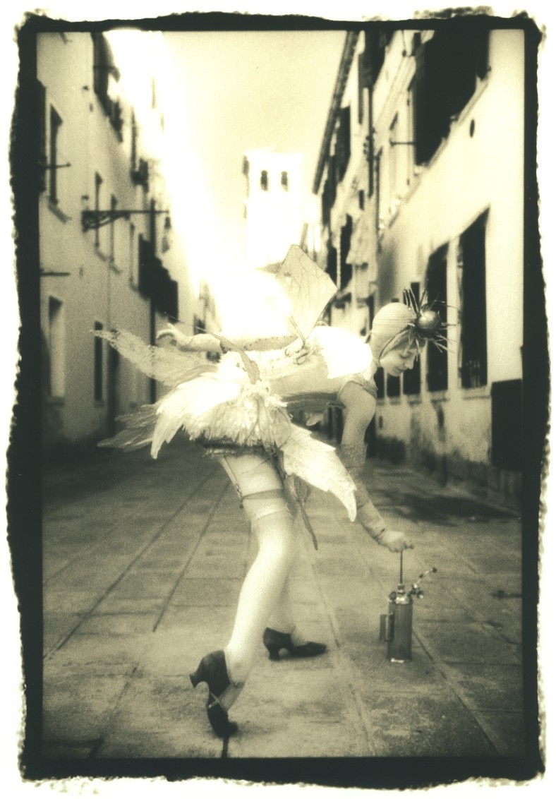
Do the model releases meet the criteria? Erin
Venice, 1996-1998
Theo Westenberger Archive
MSA.25.172.2A
Notes:
A group of girls known as “The Dolls” were photographed in 1996 and in 1998. They are Anna, Erin, Shannon and Dawa come to Carnival every year and dress in different outfits at different times of day over a period of days. They are identified once or twice in a book mock up dummy, but only ever in one outfit. I am left guessing who is which ‘Doll’ or fairy.

Slide 21
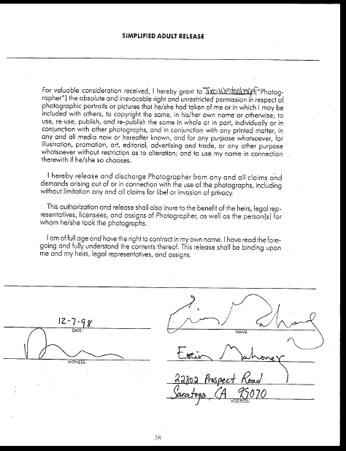
NO
No image
No shoot description
No date of shoot
Who is the witness?
Notes:
Inadequate release. It may not hold up in court in a case brought by Erin but might squeak by if a false claim was made.

Slide 22
Anna
NO!
Consent denied is worse than
no consent at all!
Notes:
One of the two principal Dolls, who refused to sign the agreement. See next slide

Slide 23
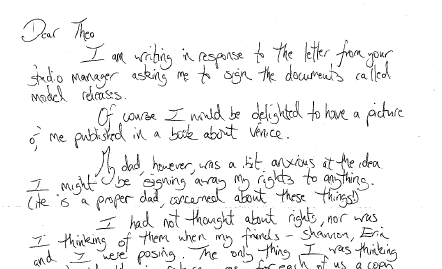
Notes:
“My day however was a bit anxious at the idea I might be signing away my rights to anything…”

Slide 24
Is the person/persona known to us?
Yes
But he is deceased
The Count, Venice, 1996
Theo Westenberger Archive
MSA.25.178.2A
Notes:
There were no additional model releases. From a careful reading of her notes we were able to identify this man, Count Emile Targhetta D'Audiffret, known as '' Le Roi du Carnaval '‘ . As the last descendant of Giacomo Casanova (1725-1792) he appeared in The Real Casanova, 2003 as the Old Casanova.
He passed away 2008

Slide 25
Is this person recognizable? Yes we will not use this image
Notes:
Persons in costume and in make-up only, we will not reproduce as their features are recognizable to themselves and others. And indeed I hope everyone remembers this hair do.

Slide 26
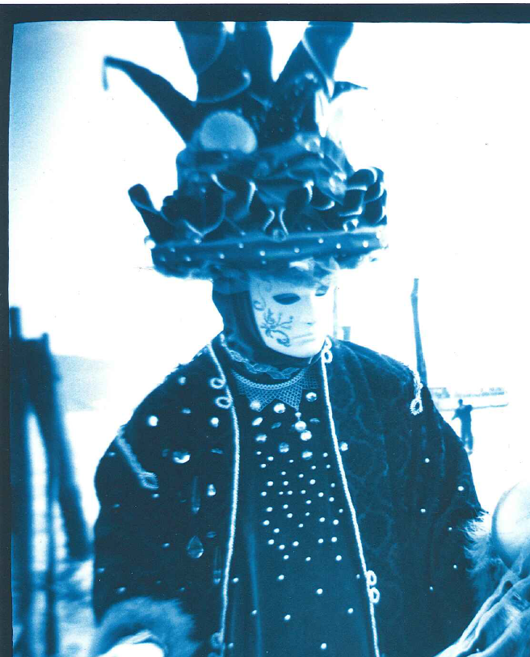
Is this person recognizable? He is in costume, with a generic face mask
At the dock, Venice, 1966
Theo Westenberger Archive
MSA.25.151.3A (detail)
Notes:
No, so we will use this image as he is not recognizable in this mask. We are not exploiting his likeness.

Slide 27
Generic masks
Notes:
Some the most exotic looking masks, to our eye, are mass produced.

Slide 28
Are these persons recognizable? Are these unique masks?
Notes:
No, these are generic masks. We will use another version of this image, without the child( the MINOR) in the frame.

Slide 29
There are many bird-like beaked masks
Notes:
Quick look in Flickr

Slide 30
Mass produced masks
Notes:
It seems a common theme although I do not know the significance of the bird.

Slide 31
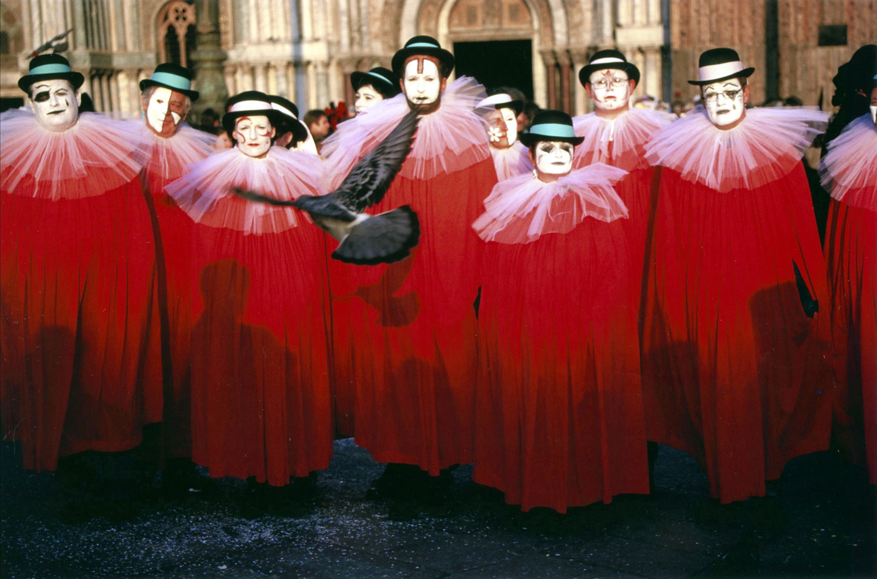
Are these people recognizable? Is this a recognizable costume that identifies this group every year?
Notes:
Identical wear meant to subsume the individual but does the costume itself become a ‘persona’

Slide 32
Yes, possibly. No, we would not license images of “The Choir”.
(from Flickr, 2004)
Notes:
I think these are the same people but the costumes have slightly changed. I will not put allow this image to be used because I think this is a ‘club’ or group and this is their signature costume.

Slide 33
This image is already available on the internet
Notes:
But I have already seen our image being used on Pinterest – borrowed I think from a national Geographic website in the 1990s.

Slide 34
This is a unique costume, we would not use this image on the internet or in marketing
Notes:
The Bubble Heads are refered to in her notes, they are a couple from Trieste who ‘dreamed’ these costumes and spent 6 months creating them.

Slide 35
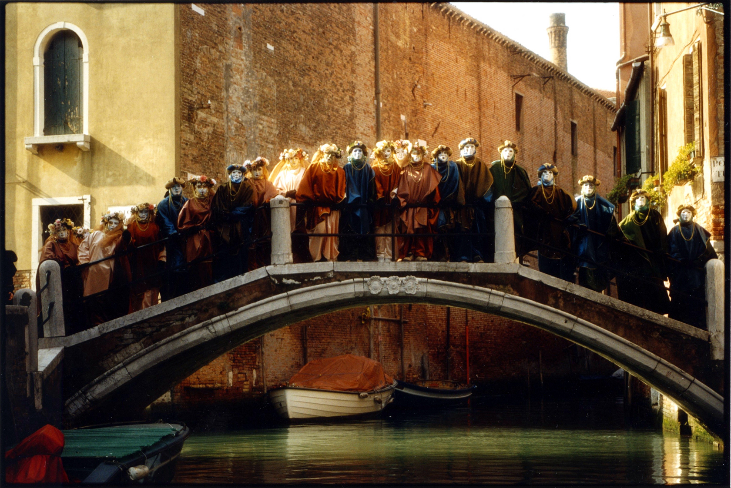
A “Naturally occurring” crowd, and yes we would use this image
China bikes
Notes:
I am not completely sure if this is a truly ‘naturally occurring crowd’ but even if it was staged no one person is prominent. We are not drawing attention to, or exploiting the likeness of any one person.

Slide 36
Are we being overcautious. Is the risk of being sued a “phantom risk”?
A claimant would have to prove:
They were there
Harm had been done by the use of the image
Autry displayed blatant disregard for their rights
Autry made no attempt to contact them
Notes:
A person depicted in the picture would have to identify the year and the location
Autry displayed blatant disregard for the rights of privacy of all persons
By releasing the images to a third party for commercial exploitation.

Slide 37
How would Autry defend a claim?
There was no expectation of privacy
The Autry had done due diligence and searched their records
Autry had a policy in place that respected individual rights
Notes:
There was no expectation of privacy on the streets of Venice during Carnevale. The subjects were all in a public place, dressed to be seen, there voluntarily and aware that they were being photographed
The Autry could claim that personnel had done due diligence in searching all the records in their possession for identifications.
Autry had withheld other images of performers, prominent persons, or anyone who could be recognized by their facial features

Slide 38
Risk Assessment procedure
Checklist
First pass by archival assistant
Second pass with Archivist
Paperwork completed and filed with a copy of the image
Notes:
We have a checklist. If any of those conditions ( such as is the person visible a minor etc) are met we immediately put the image aside and will not digitize and circulate the image. It will be available to researcher on site.

Slide 39
Publicity (celebrity)
Rights of Publicity
the right to control how their image is used
rights of publicity survive their owners
They must be conferred by will.
Notes:
Well known person have the right to exploit their own likeness and persona for commercial purposes and that right continues after their death if it has been conferred by will. In the case of Fred Astaire, Robin Astaire his widow controls all commercial use of his image.

Slide 40
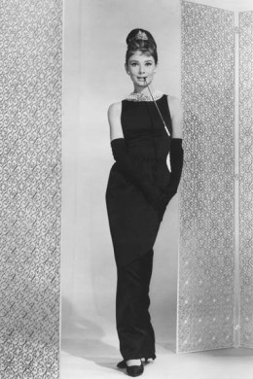
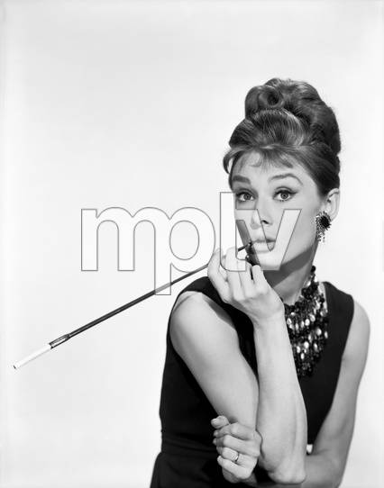
Paramount Pictures: by Bud Fracke While this image for sale it is already viral ‘viral’
Notes:
Bud Fracke was also the head of the photography department at Paramount. The original of this image at left is still in the archives at Paramount. Another version or copy of the image is for sale in an agency MPTV that represents Bud Fracke photography ( and many others).

Slide 41
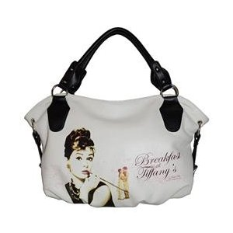
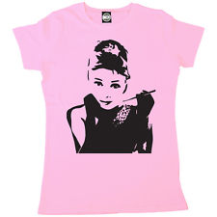
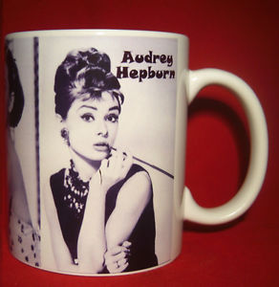
The copyright and the rights of publicity are unchallenged and now cannot be asserted
Notes:
Some of the 100s of merchandise that bear Audrey Hepburn image from “Breakfast at Tiffanys”. The studio has never challenged the use of this image in a commercial venture. They have essentially lost the copyright as the image is for all extents and purposes in the public domain.

Slide 42
Have you already gone viral?
Jennifer Aniston, 1996
Theo Westenberger Archive
MSA.25
Notes:
So in our case we want to make sure that we do not lose the copyright of the collection through negligence, that is allowing the image to circulate unchallenged.

Slide 43
Reverse Search Engine
www.tineye.com
for file: Jennifer Aniston.jpg
7 Results
5 billion images searched in 0.001 seconds.
TinEye free for non-commercial purposes
A fan club, a Greek cooking site, a fashion blog, an hip arabic site, and three pornography sites
Notes:
Using a reverse search engine we can see that this image has already been used and is avaiable through a google search. Legal departments will have to decide when and if to pursue a copyright infringment or unlicensed use.

Slide 44
Practices in celebrity photography 1985-2014 onwards
Celebrity photography was a very lucrative business. After a photo shoot for a magazine the photographer would place the material in the hands of their agents to resell nationally and internationally. There were these types of shoots:
Publicity shoots
Editorial shoots
On set photography
Special photography for marketing, posters etc
Notes:
Because syndication yielded huge profits photographers were willing to give photo approval to stars ( i.e. sign away the right to reproduce some of the take) in order to have the right to sell others even if that number of images was severely restricted. Successful celebrity photographers in the 1990s were making up to $400,000 a year from the resale of celebrity portraits.

Slide 45
Editorial photography : Publicists
In this period a Publicist brokered every shoot, editorial and commercial with an actor prior to the shoot:
“The pre-shoot agreement” letter
the “ shoot memo” given to a photographer the night before the shoot
These committed the photographer to an on-going obligation to seek publicists approval for placement
Notes:
The publicists controlled the terms of the shoot and the approval process with the photographer. Magazines absolutely refused to give photo approval to the star or publicists prior to the first printing.

Slide 46
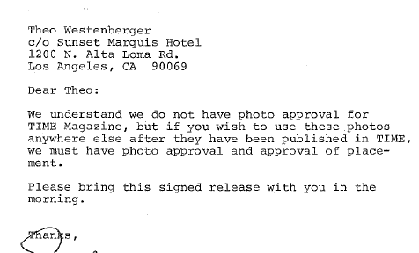
Pre-shoot Agreements
Notes:
The night before the shoot

Slide 47
Shoot Agreements
Notes:
I only have this document for ONE shoot and I know they were used in almost all the celebrity shoots during this period. These documents are still in use today and celebrity photographer have to sign them.

Slide 48
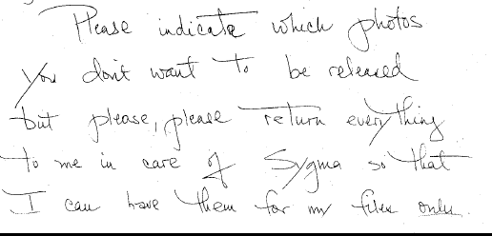
Post-shoot Approval
Notes:
So we may have the images in our files but how are they labelled? Are they separated? How do I know which are the approved and which are the KILLED.

Slide 49
Editorial photography: Lawyers
In the absence of a publicist sometimes a lawyer would represent the subject and restrict the resale or placement of images.
Require approval, specific and limited uses
Require single use only, restricting syndication
Sometimes require approvals
Notes:
Prominent persons also sought to restrict the resale or republication of images shot for magazines.

Slide 50
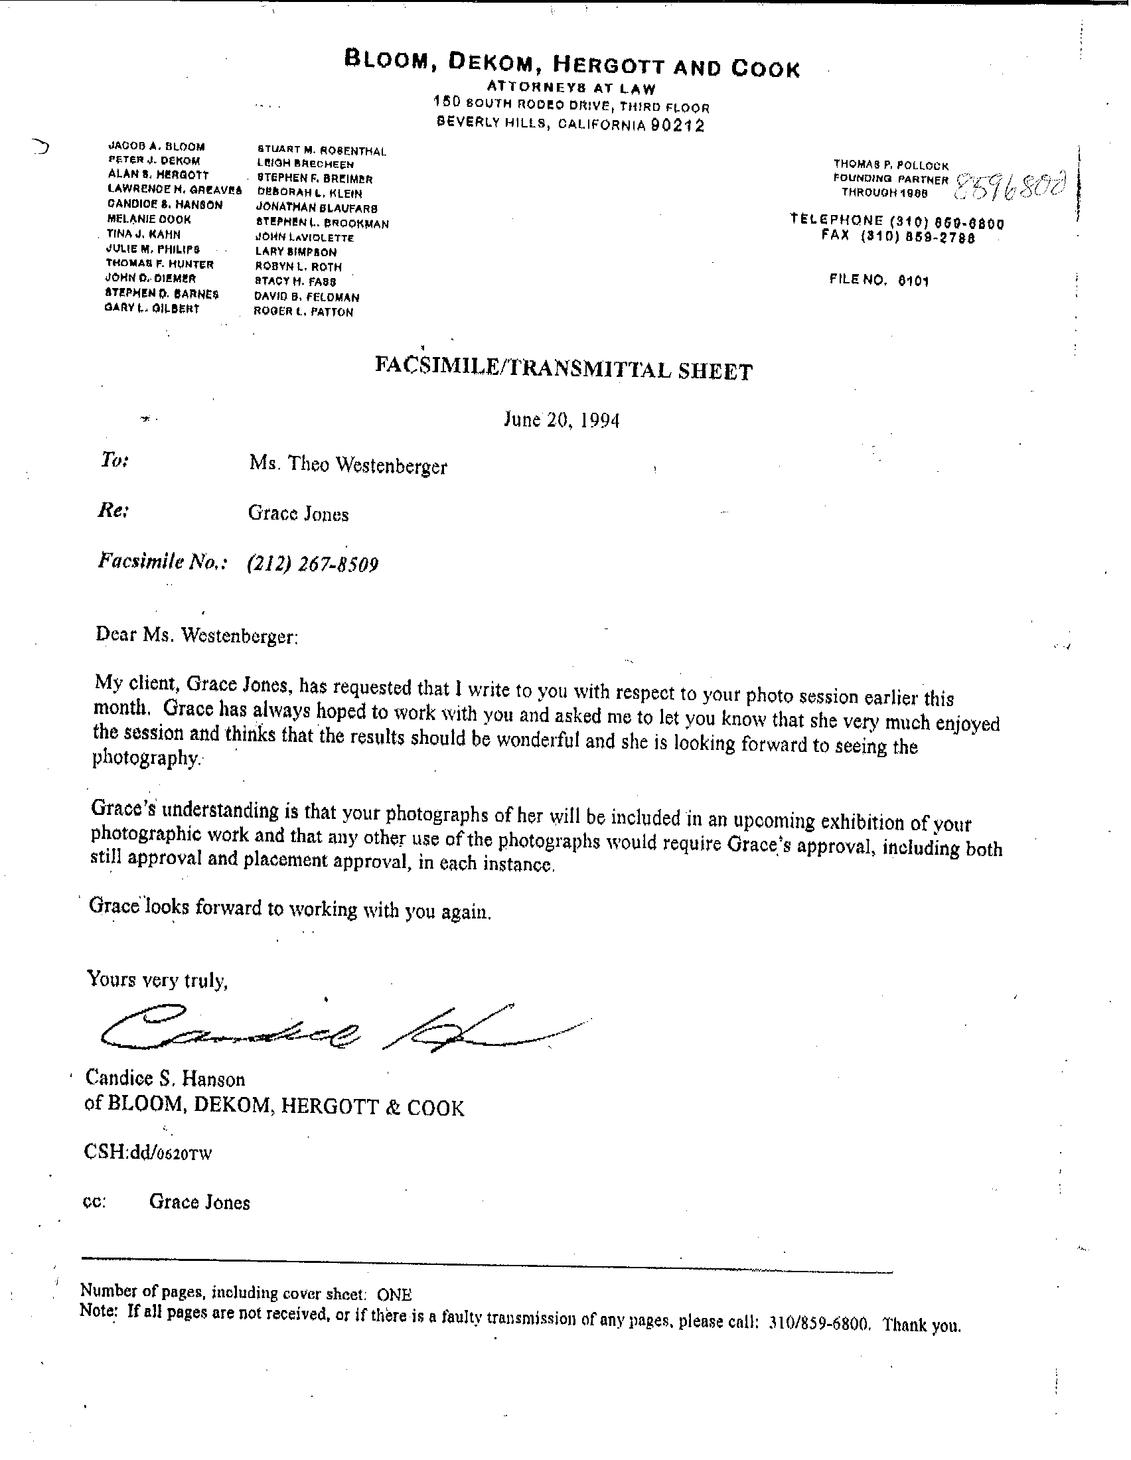
Notes:
This shoot involved nudity so this is understandable.

Slide 51
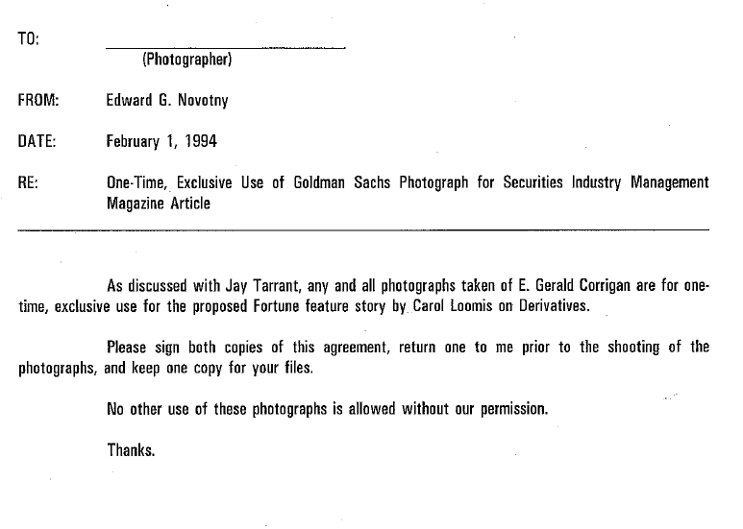
Businessmen
Notes:
This can only be explained by the fact that businessmen are either very vain, afraid of being too well known or just control freaks.

Slide 52
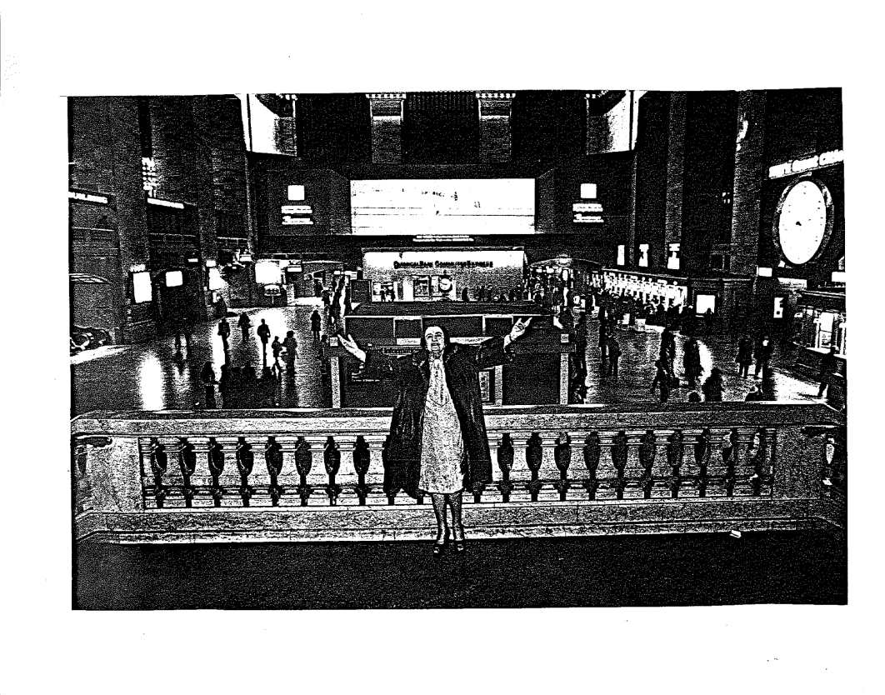
Persons of Note : Ayn Rand 1979
Notes:
And other people just think very highly of themselves.

Slide 53
On set Photography
Celebrities are granted ‘KILL’ rights by movie studios
Kills coordinated by the studio
Approved by the producer/director
Syndication rights may be given to the photographer ( pre 1990)
Notes:
When actors are shot in character the images are often part of a ‘buyout’ – that is the studio or TV production company owns all the images after the shoot. Certainly the right to reproduce those characters in prunt is the right of the studio, the production company, the distributor or the producer.

Slide 54
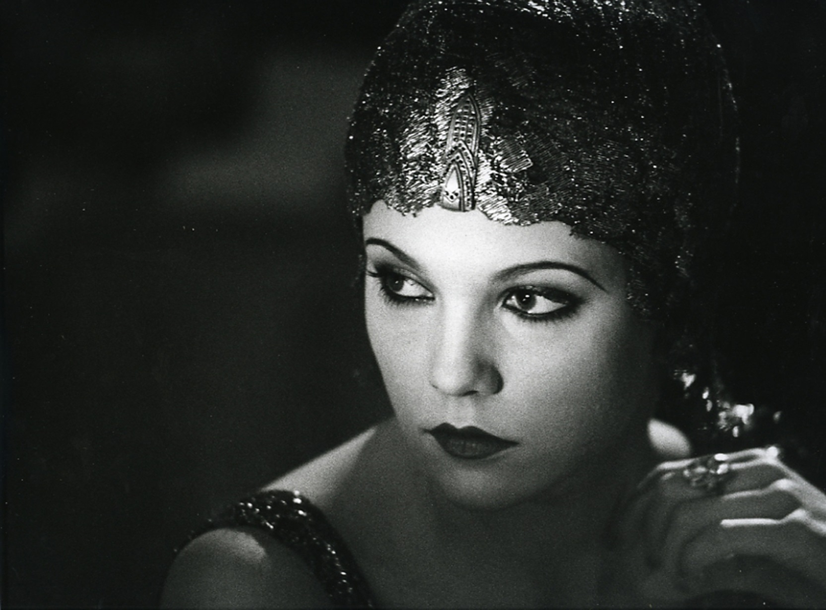
Diane Lane, in the Cotton Club, 1983
Notes:
Theo was on set during the shooting of The Cotton Club and used some images for many years later as portfolio pieces. Also the images were syndicated through her agency Gamma Liasion and then Sygma with the full cooperation and backing of the studio but the approval process had to take place before the syndication was allowed. It was to the studios benefit to have the images widely available. This was an efficient marketing decision in the days before digital files.

Slide 55
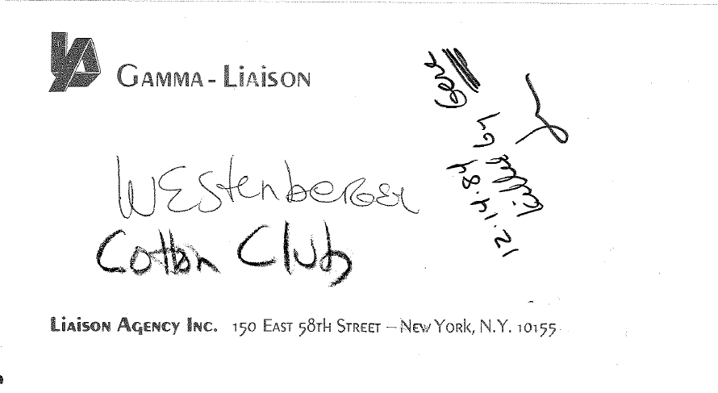
“Killed by Gere”
Notes:
Approved art and killed art was returned to agency. We were lucky that the killed art was still in the envelopes and we were able to transfer that information to our records.

Slide 56
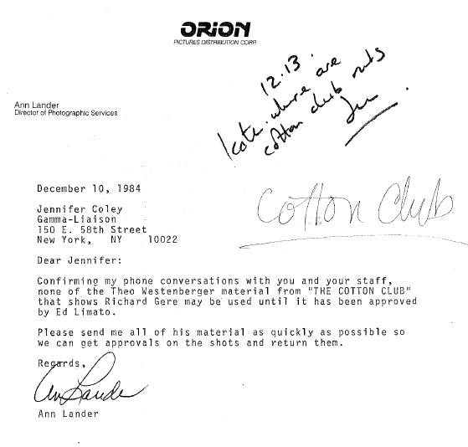
Layers of approvals
Notes:
Which I am sure the movie studio archivists could talk to you about in depth.

Slide 57
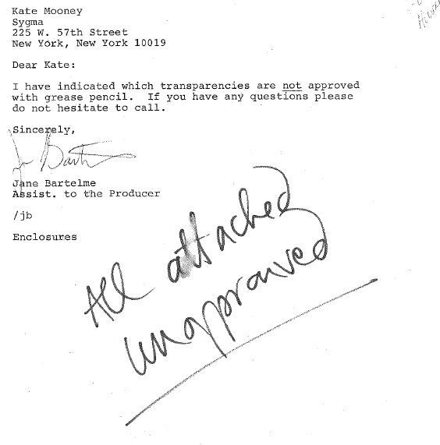
Where are they now?
Notes:
But how much information has been lost in the filing…there were no images attached to this note.

Slide 58
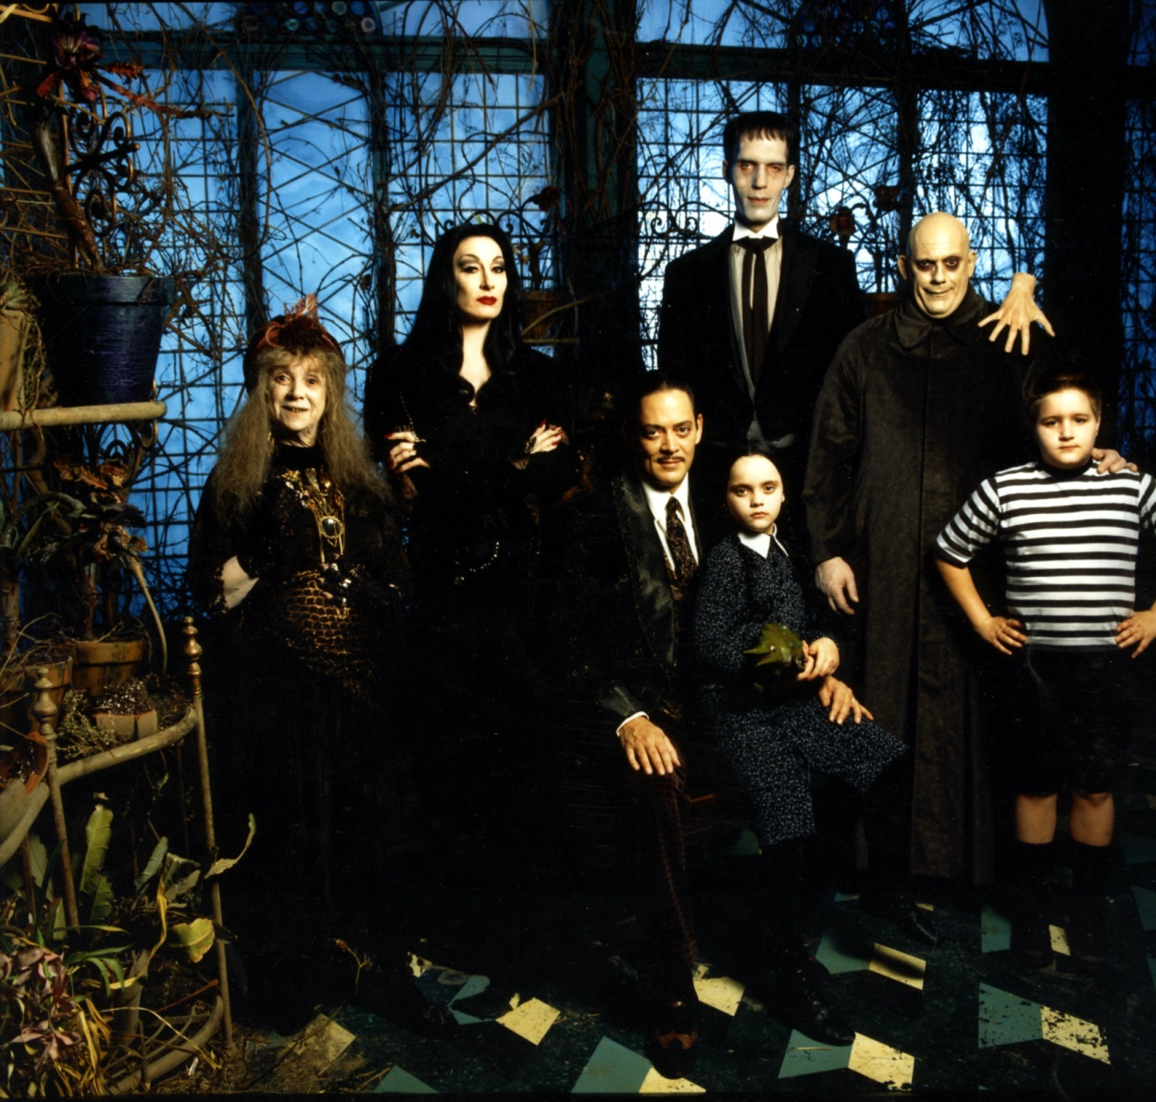
Special Photography; Publicity
Addams Family,
Paramount Pictures
Theo Westenberger Archive
MSA.25
Notes:
Often special photography was used by the studio but also release to the photographer to be syndicated through their agency. This ensured the availability of great material in print as the film was released. And the agency sold exclusivity to the highest bidder in the US and abroad.

Slide 59
Special photography: Marketing
Add
Notes:
Special photography for posters was always ‘work for hire’ – the photographer did not have any further rights to the imagery. While this was true, there are still some images from these takes in the files. They cannot be circulated.

Slide 60
We should have paperwork for…
George Clooney Arnold Schwarzenegger Billy Crystal Michael J Fox Harry Belafonte Michael Douglas Charlie Sheen Bette Midler Susan Sarandon Sigourney Weaver Jane Seymour Steve Martin John Candy Matt Dillon James Garner Jodi Foster Molly Ringwald Bruce Willis Candace Bergen George Foreman Joan Allen Joan Cusack Ann Magnuson John Travolta Kelly Preston Mel Gibson George Miller Connie Chung Danny Devito Meryl Streep Paul Simon Jenna Elfman Whoopi Goldberg Michael Jordan Keanu Reeves Kenneth Branagh David Letterman Steven Spielberg Dennis Quaid Richard Gere James Cameron Alec Baldwin Jeff Bridges Harry Connick Jnr Ray Charles Francis Ford Coppola Ron Howard Ralph Lauren Elizabeth McGovern James Spader Barbara Herchey Mathew Broderick David Lee Roth ozzy Osbourne Anne Hathaway Joan Rivers Sissy Spacek Kevin Costner Sting Will Smith……and counting
The Devil Wears Prada Addams Family The New Kids Train Planes and Automobiles Biloxi Blues Without a Trace A Man and A Woman The Pirate Movie Maverick Miracles Much Ado about Nothing Regarding Henry Family Stone Racing with the Moon Dennis the Menace Home Alone Edward Scissorhands The Brady Bunch The Cotton Club Footloose Her Alibi Junior Hunt for Red October The River Rat Terms of Endearment The Dead Money Trouble Running Scared The Firm Scrooged Class Action Beetlejuice Bitter Markings Innocent Blood bad Medecine Maid to Order Mrs Soffel Next of Kin Naked Gun 2 1/2The Serpent and The Rainbow Terminator Two of a Kind Unfaithfully Yours Wise Guys Wall Street The Year of Living Dangerously Total Recall The Rescue Wilder Napalm Sunset The Guardian
Notes:
So while I know how celebrity photography was practiced I do not have the contracts, the deal memo, the agreements, etc on all these projects.

Slide 61
And we have informative paperwork for about
.0001%
So we proceed with caution, lots of it…
Notes:
So we have to be careful.

Slide 62
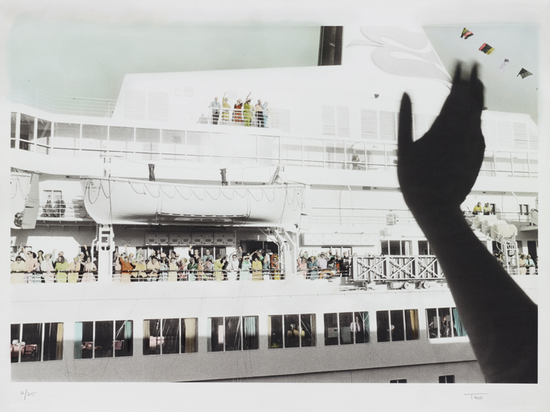
Bon Voyage, Long Beach, 1970-1975
Theo Westenberger Archive
MSA.25.40.2A

